Slide 1

A Network on A Cloud Platform
Felicia Watson
Introduction to Cloud Computing
Network211
Professor Joe Njoloma
6/21/2023

Slide 2

INTRODUCTION
This project is about building a network on a cloud platform and exploring cloud computing platforms and Services. While exploring virtualization and cloud computing. Exploring arears with such as hardware virtualization, cloud infrastructure, cloud security, and cloud storage. Cloud migration, capacity planning, and performance monitoring are also covered.

Slide 3

NETW211 Course Project
Module 2 Virtual Machine (VM) Instances

Slide 4
Activity | Requirement(s) | Points
Deploying a VM in Azure | Screenshot | 10
Connecting to the VM | Screenshot | 10
Deleting the VM | Screenshot | 10
Rubric

Slide 5
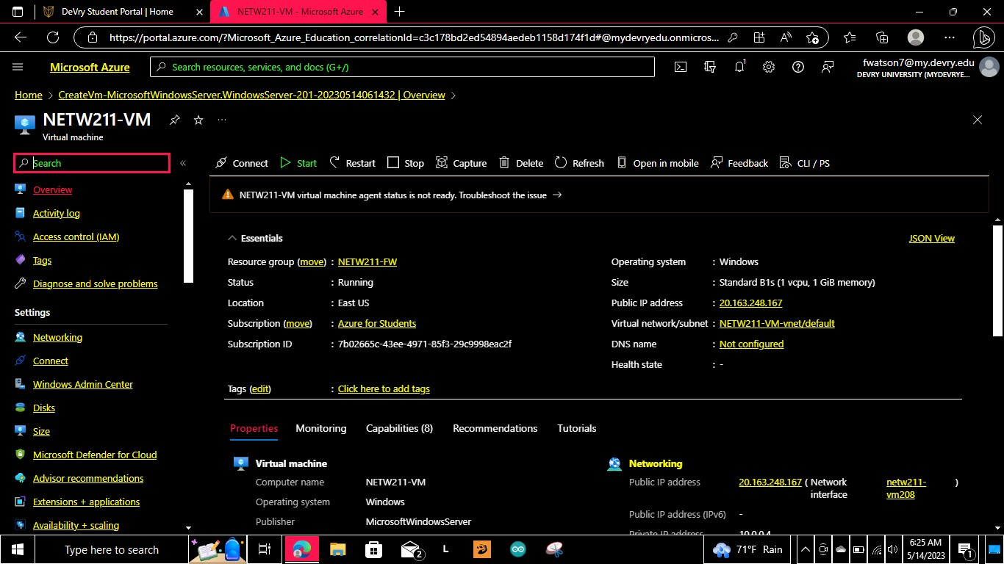
Deploying a VM in Azure
This screenshot should show the NETW211VM page with information such as the resource group name, subscription, public IP address, etc.

Slide 6
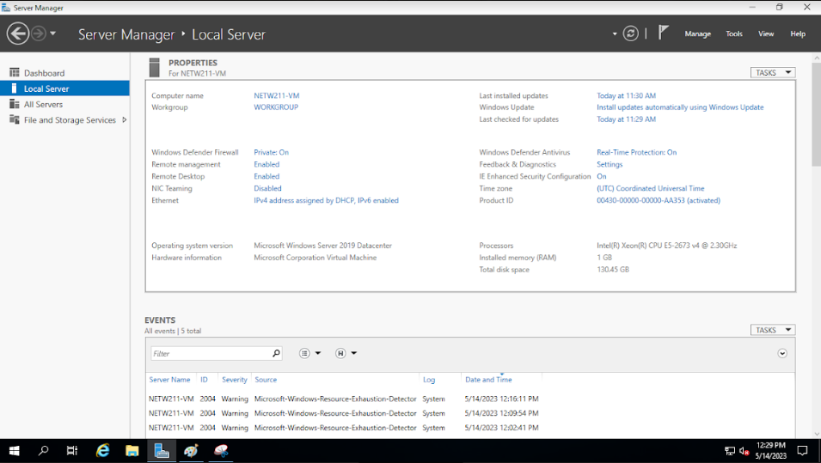
Connecting to the VM
This screenshot should show the PROPERTIES for NETW211VM page, with the computer name, operating system version, hardware information, etc.

Slide 7
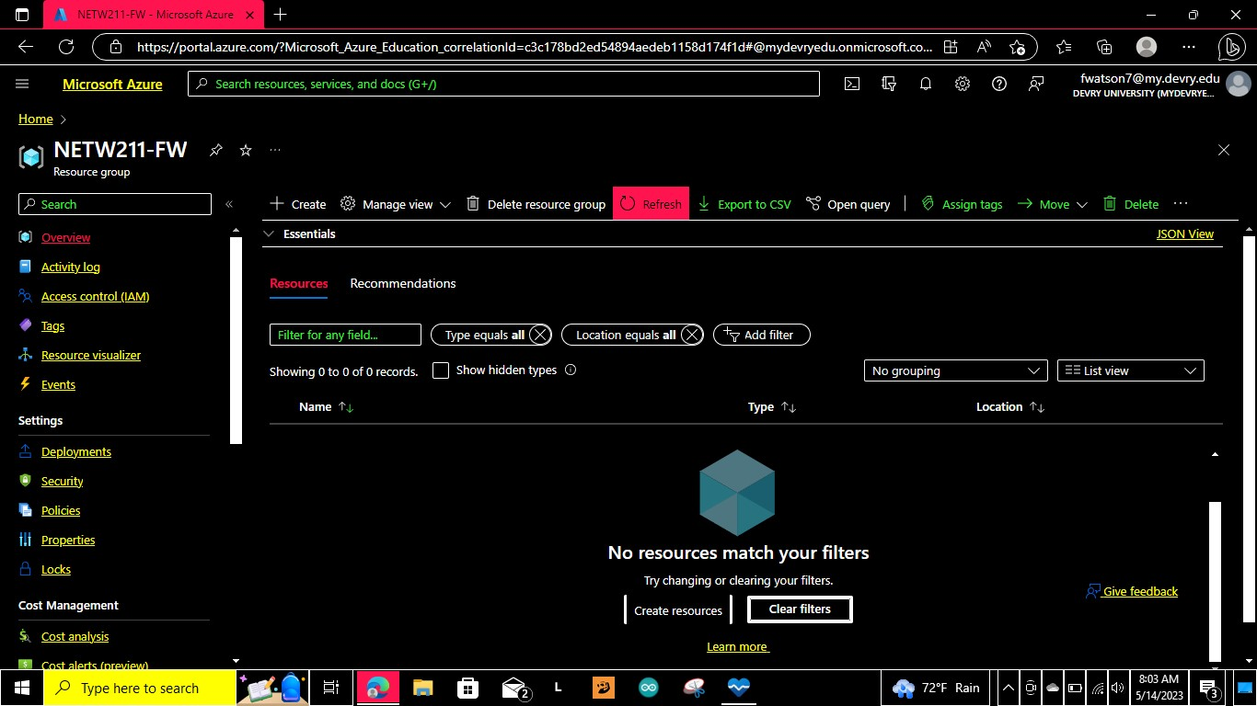
Deleting the VM
This screenshot should show the Resource groups page, with the Subscription == all selection, but without the NETW211-XX (Your Initials) resource group listed.

Slide 8
NETW211 Course Project
Module 3 Azure VNet and Subnets

Slide 9
Rubric
Activity | Requirement(s) | Points
Creating a VNet with Two Subnets | Questions | 20
Deploying VMs into Subnets | Three Screenshots | 30
Verifying Connectivity between VMs | Two Screenshots | 10

Slide 10
Creating a VNet with Two Subnets
1. With a /24 network prefix, how many usable IPv4 host addresses are there? [hint: you learned this in NETW191]
Answer here: 254
2. Given the answer above, why is the number of available IP addresses for Subnet0 (10.0.0.0/24) or Subnet1 (10.0.1.0/24) shown as 251? [hint: where did the missing addresses go?]
Answer here: For IPv4 you cannot use the network or broadcast addresses as host address.
References (here are two examples to get your research started):
1. IP Subnet Calculator, https://www.calculator.net/ip-subnet-calculator.html
2. Azure Virtual Network frequently asked questions, https://docs.microsoft.com/en-us/azure/virtual-network/virtual-networks-faq
3.Professor Geome
4.https://www.chegg.com/auth?type=simplifiedstudy&action=signup&data=&redirect=/cspofferinterstitial/ib

Slide 11
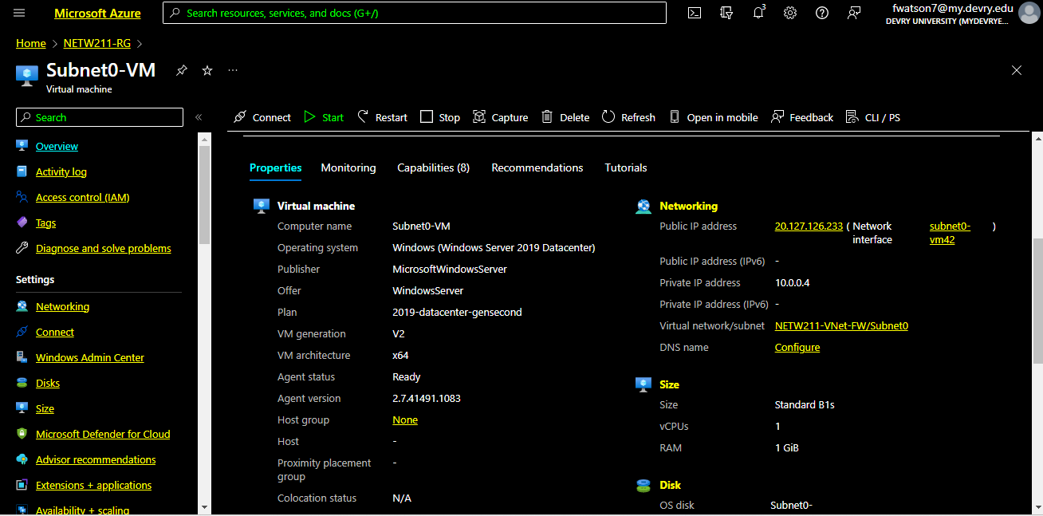
Deploying VMs into Subnets
This screenshot should show the Properties section of the Subnet0-VM page, showing the networking and size information of the VM.

Slide 12
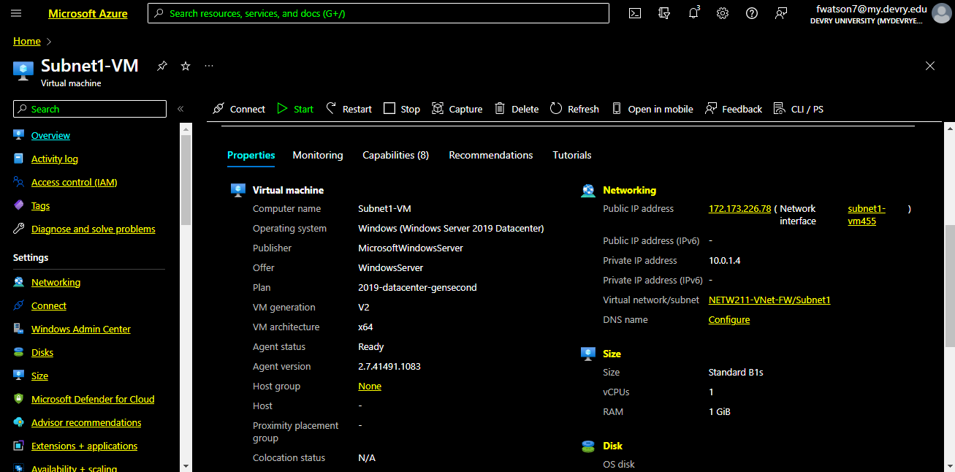
Deploying VMs into Subnets cont’d
This screenshot should show the Properties section of the Subnet1-VM page, showing the networking and size information of the VM.

Slide 13
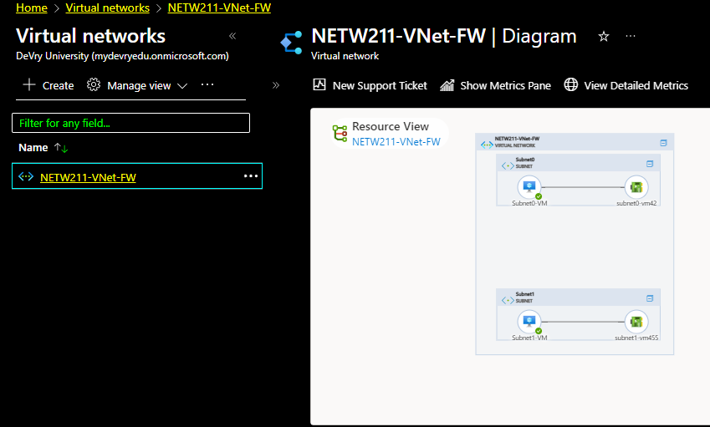
Deploying VMs into Subnets cont’d
This screenshot should show the topology diagram of your VNet (NETW211-VNet-Your Initials) with two subnets (Subnet0 and Subnet1) and one VM in each subnet (Subnet0-VM and Subnet1-VM).

Slide 14
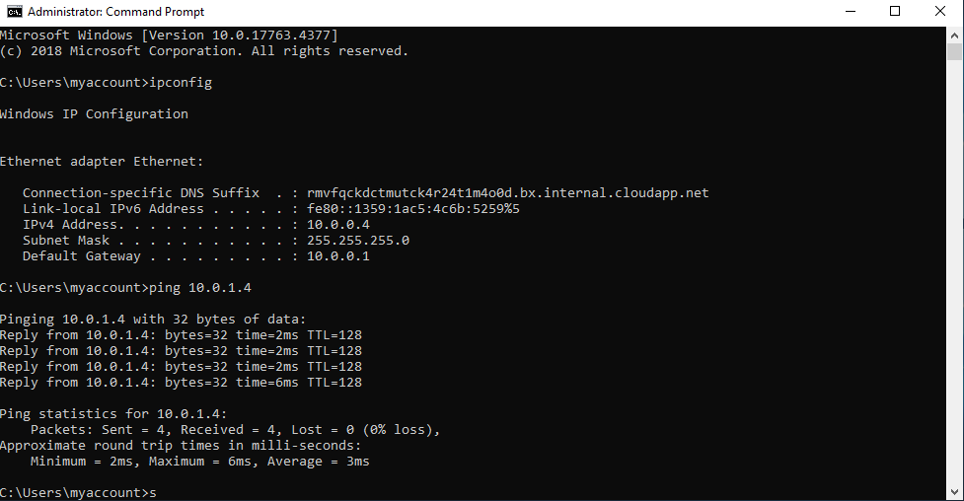
Verifying Connectivity between VMs
This screenshot should show the ipconfig and ping x.x.x.x results in the command prompt window, including the Subnet0-VM – x.x.x.x – Romote Desktop Connection window title.

Slide 15
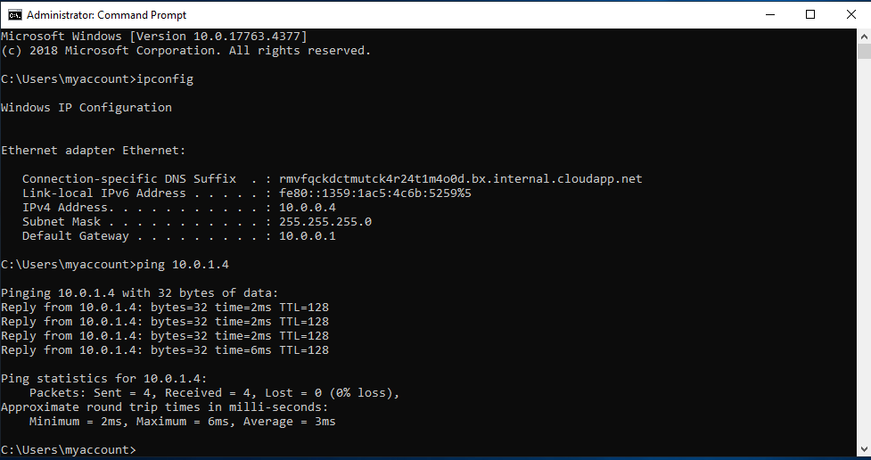
Verifying Connectivity between VMs
cont’d
This screenshot should show the ipconfig and ping x.x.x.x results in the command prompt window, including the Subnet1-VM – x.x.x.x – Romote Desktop Connection window title.

Slide 16

NETW211 Course Project
Module 4 Azure VM Security

Slide 17
Rubric
Activity | Requirement(s) | Points
Launching a VM | Screenshot | 15
Connecting to the VM via SSH | Screenshot | 15
Configuring an NSG | Two screenshots | 30

Slide 18
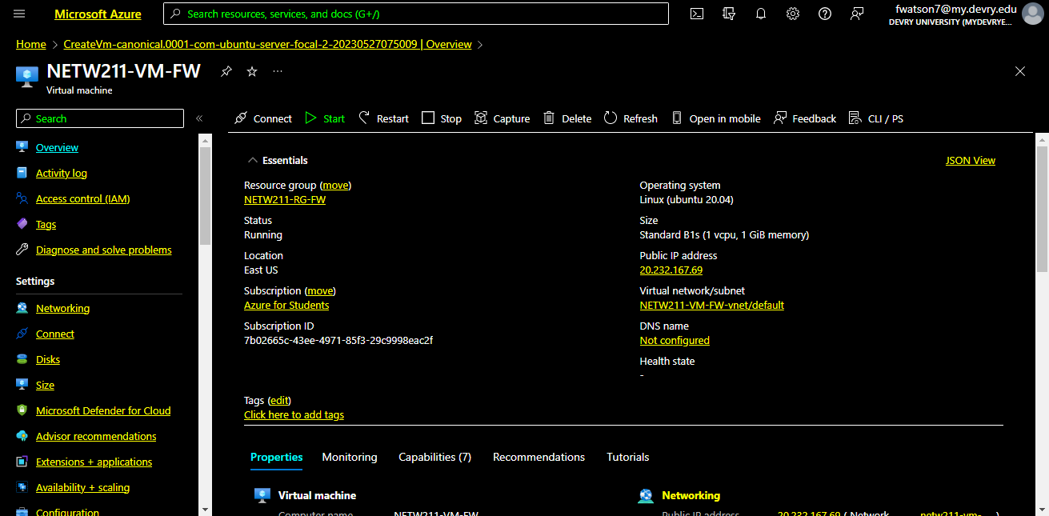
Launching a VM
This screenshot should show the NETW211-VM-Your Initials page, with
information such
as the resource
group name,
subscription,
public IP
address, etc.

Slide 19
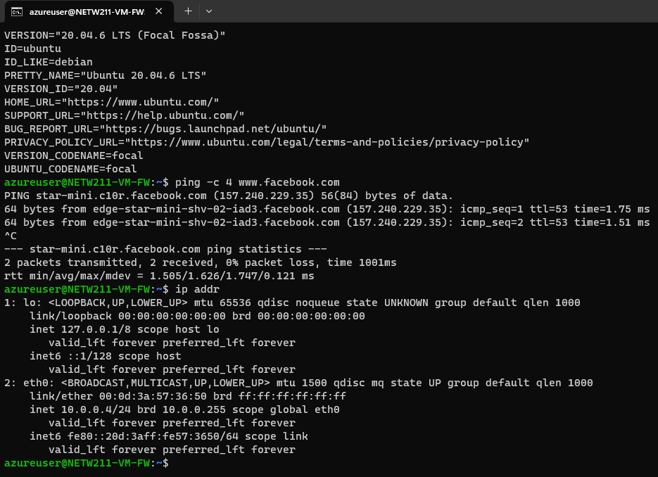
Connecting to the VM
via SSH
This screenshot should show the azureuser@NETW211-VM-Your Initials window showing the IPv4 address of the VM in the Azure cloud.

Slide 20
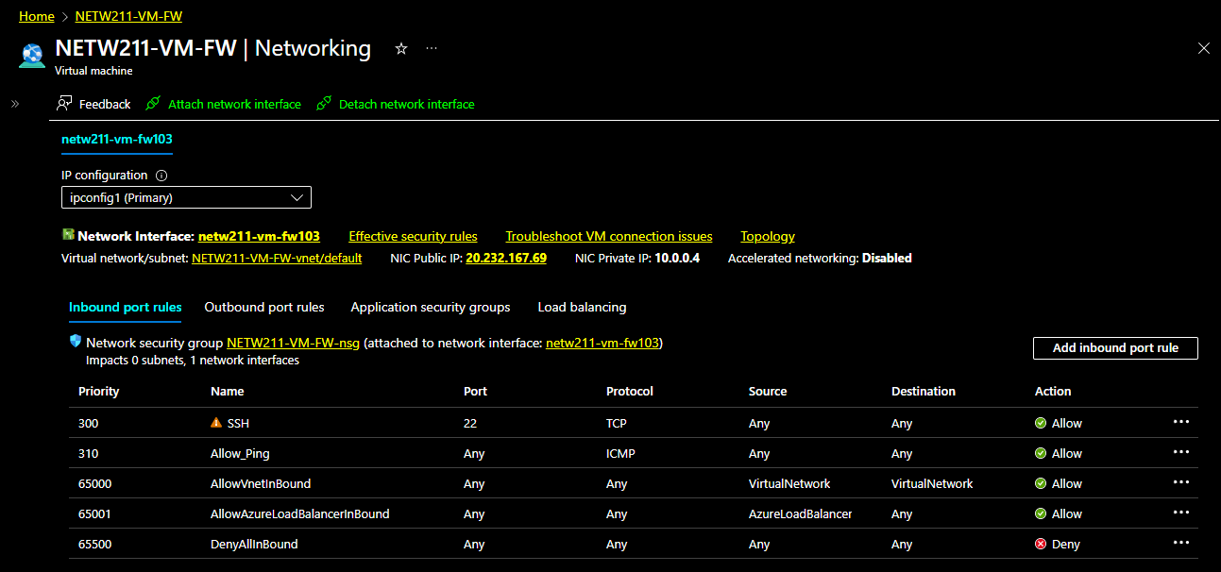
Configuring an NSG
This screenshot should show the Inbound port rules section with the newly added Allow_Ping rule.

Slide 21
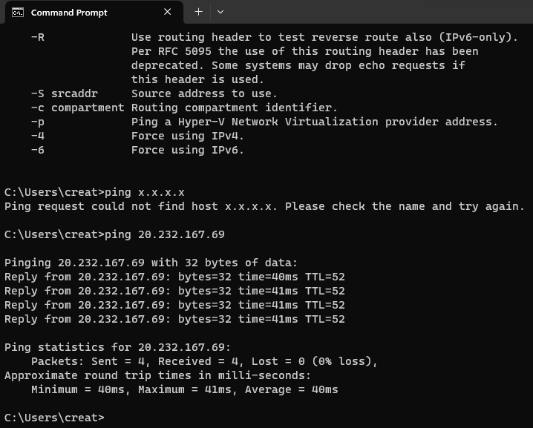
Configuring an NSG
cont’d
This screenshot should show the successful ping result from your local computer to the VM in the Azure cloud.

Slide 22


NETW211 Course Project
Module 5 Cloud Storage

Slide 23
Activity | Requirement(s) | Points
Uploading and Accessing a File | Screenshot | 15
Creating Blob Snapshots | Question, Screenshot | 30
Enabling Blob Versioning | Screenshot | 15
Rubric

Slide 24
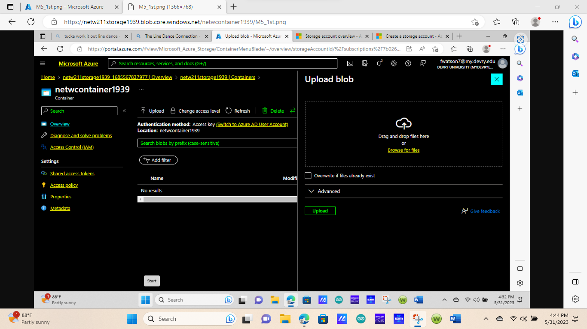
Uploading and Accessing a File
This screenshot should show the browser window with the image uploaded from your local computer and the URL on top of the window.

Slide 25

Question
What does the access tier setting do? What are the Azure blob storage access tiers?
[hint: in the Azure portal, on the Upload blob page, under Advanced, click the ? circle above the Access tier box.]
Answer here:
When your data is stored in an online access tier (either hot, cool or cold), users can access it immediately.
Set Blob Tier (REST API) - Azure Storage | Microsoft Learn
References (here are two examples to get your research started):
1. Hot, Cool, and Archive access tiers for blob data, https://docs.microsoft.com/en-us/azure/storage/blobs/access-tiers-overview
2. Azure Blob Storage Access Tiers, https://devry.percipio.com/courses/c7ef0333-8560-403f-a004-9c5c843866b0/videos/2658bbe6-ee97-438b-a376-fbb079c3b3a0
3.Setting or changing a blob’s tier https://learn.microsoft.com/en-us/rest/api/storageservices/set-blob-tier?tabs=azure-ad
4.Set the default access tier for a storage account, https://learn.microsoft.com/en-us/azure/storage/blobs/access-tiers-overview?tabs=azure-portal#default-account-access-tier-setting

Slide 26
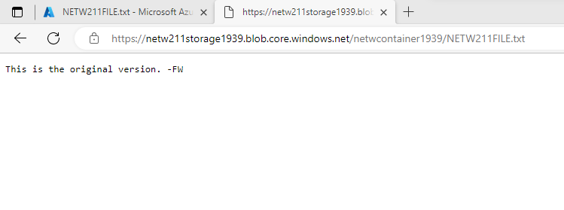
Creating Blob Snapshots
This screenshot should show the browser window with the “This is the original version. –Your Initials” message and the URL on top of the window

Slide 27
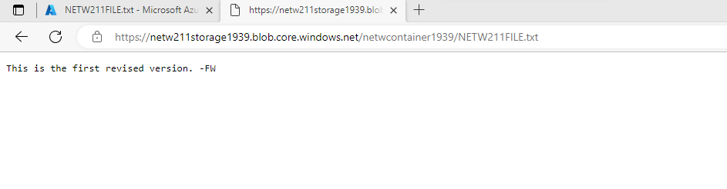
Enabling Blob Versioning
This screenshot should show the browser window with the “This is the first revised version. –Your Initials” message and the URL on top of the window.

Slide 28
NETW211 Course Project
Module 6 Cloud Monitoring

Slide 29
Rubric
Activity | Requirement(s) | Points
Setting up an Action Group and Notifications | Screenshot | 20
Setting up Alert Rules | Screenshot | 20
Testing Alerts | Two screenshots | 20

Slide 30
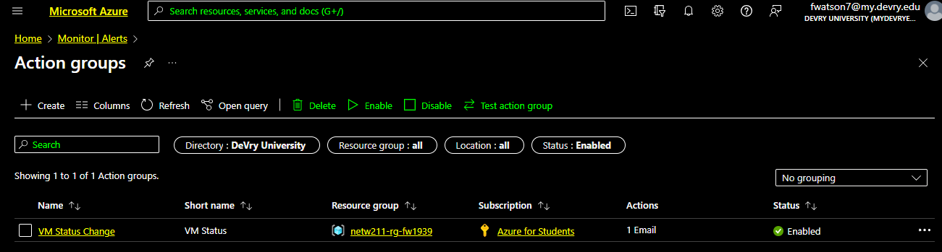
Setting up an Action Group and Notifications
This screenshot should show the “VM-Status-Change” action group on the Manage actions page.

Slide 31
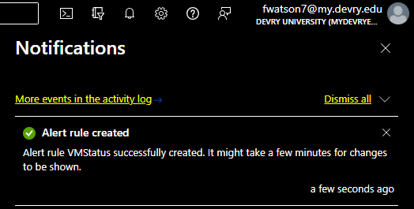
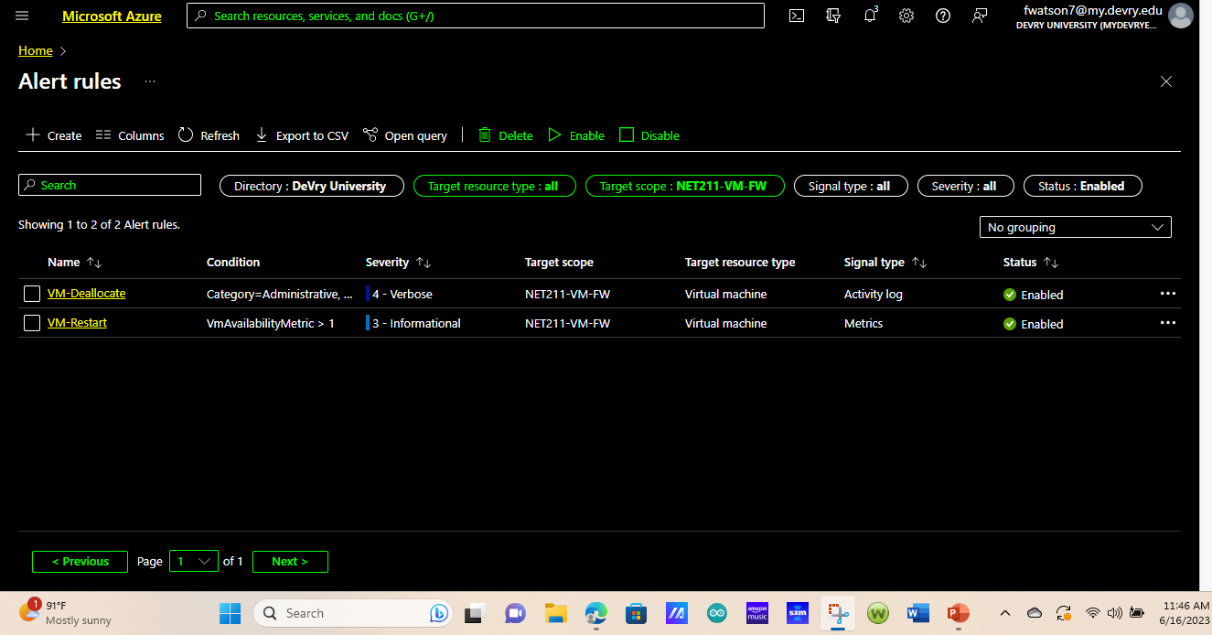
Setting up Alert Rules
This screenshot should show the Alert rules window showing the VM-Deallocate and VM-Restart rules.

Slide 32
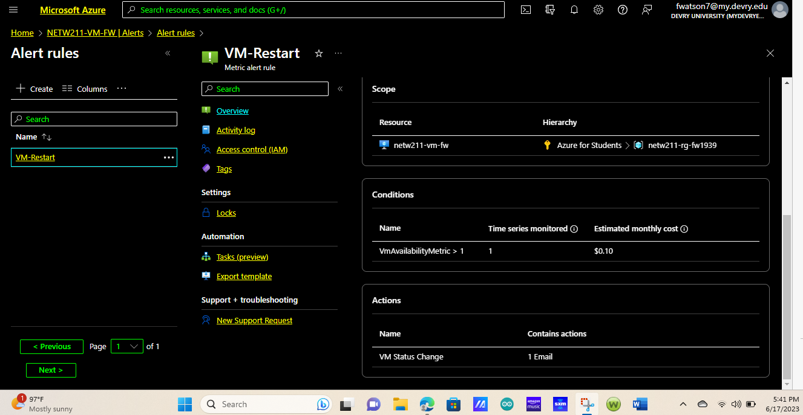
Testing Alerts
This screenshot should show the ‘VM-Restart’ was activated email message with the date and time of the alert.

Slide 33
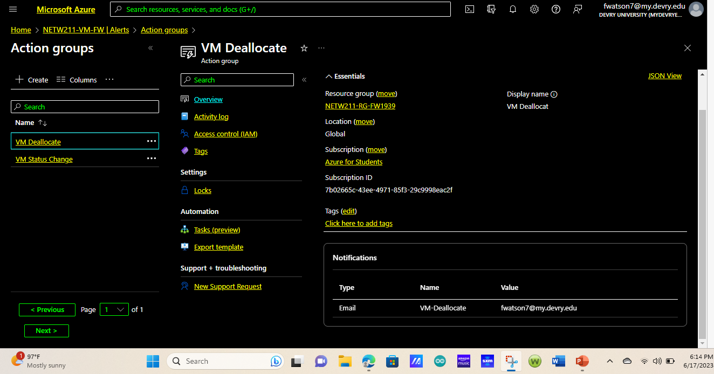
Testing Alerts cont’d
This screenshot should show the ‘VM-Deallocate’ was activated email message with the date and time of the alert.

Slide 34

CHALLENGES
I had an issue with the Network watcher. It wasn’t in stalled.
I resolved it by researching in Azure. After researching the steps on how to install the network watcher. I applied those steps to get the outcome that were required.

Slide 35

CAREER SKILLS
Career skills obtained processing this project
Cloud Monitoring and Automation
Cloud Migration Planning and Execution
Cloud Deployment and Backup Techniques
Azure Virtual Networking

Slide 36
CONCLUSION
I Learned what cloud computing is about. I also learned types of cloud deployments, cloud service models, and troubleshooting methodology. ​ ​While Exploring cloud computing platforms and services. Which is accomplished through practical.

Slide 37
CompTIA Cloud+ Guide to Cloud Computing, Jill West, ISBN-10: 0-357-11425-6, ISBN-13: 978-0-357-11425-4.
/azure/network-watcher/network-watcher-monitoring
REFERENCE

