Slide 1

This slide presentation is about applied physics.
I will be using a transducer to perform physical measurements and analyze the problems that occur in nature. Logarithms and trigonometry will be applied to my results.
Included my experiments on
  Force and motion
  Matter and energy
  Energy conservation
  Electricity and magnetism
  Heat and light

Slide 2
TECH204
Project Parts
Inventory of Parts and Software

Slide 3
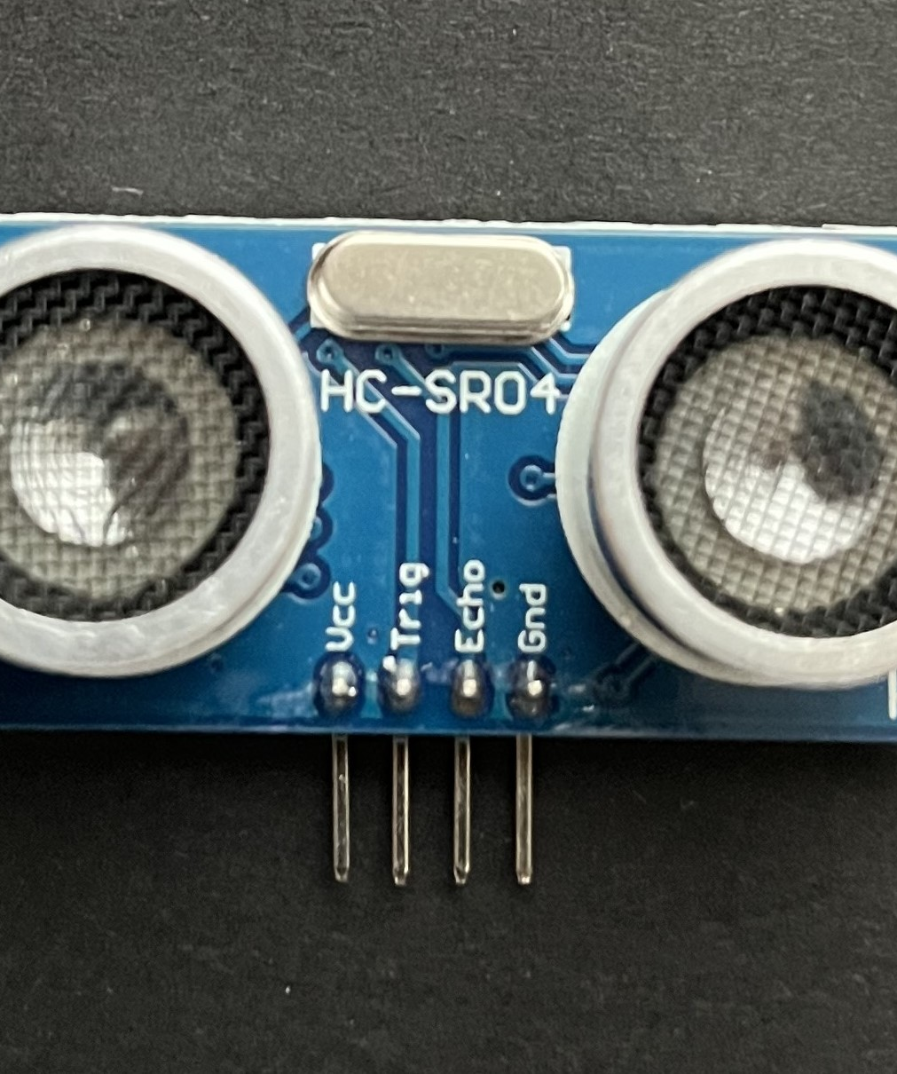
Ultrasonic Sensor HC-SR04
The Working Principles of Ultrasonic Sensors work on the principle
Emission of Sound Waves: The sensor's transmitter generates a burst of ultrasonic sound waves. These sound waves travel through the air until they encounter an object.
Reflection of Sound Waves: When the emitted sound waves hit an object, the sound waves bounce back towards the sensor. This reflection is crucial for distance measurement.
Reception of Echoes: The sensor's receiver detects the reflected sound waves. The time taken for the sound waves to travel to the object and back is measured.
Distance Calculation: The distance to the object is calculated using Distance = Speed of Sound x 2
  2

Slide 4
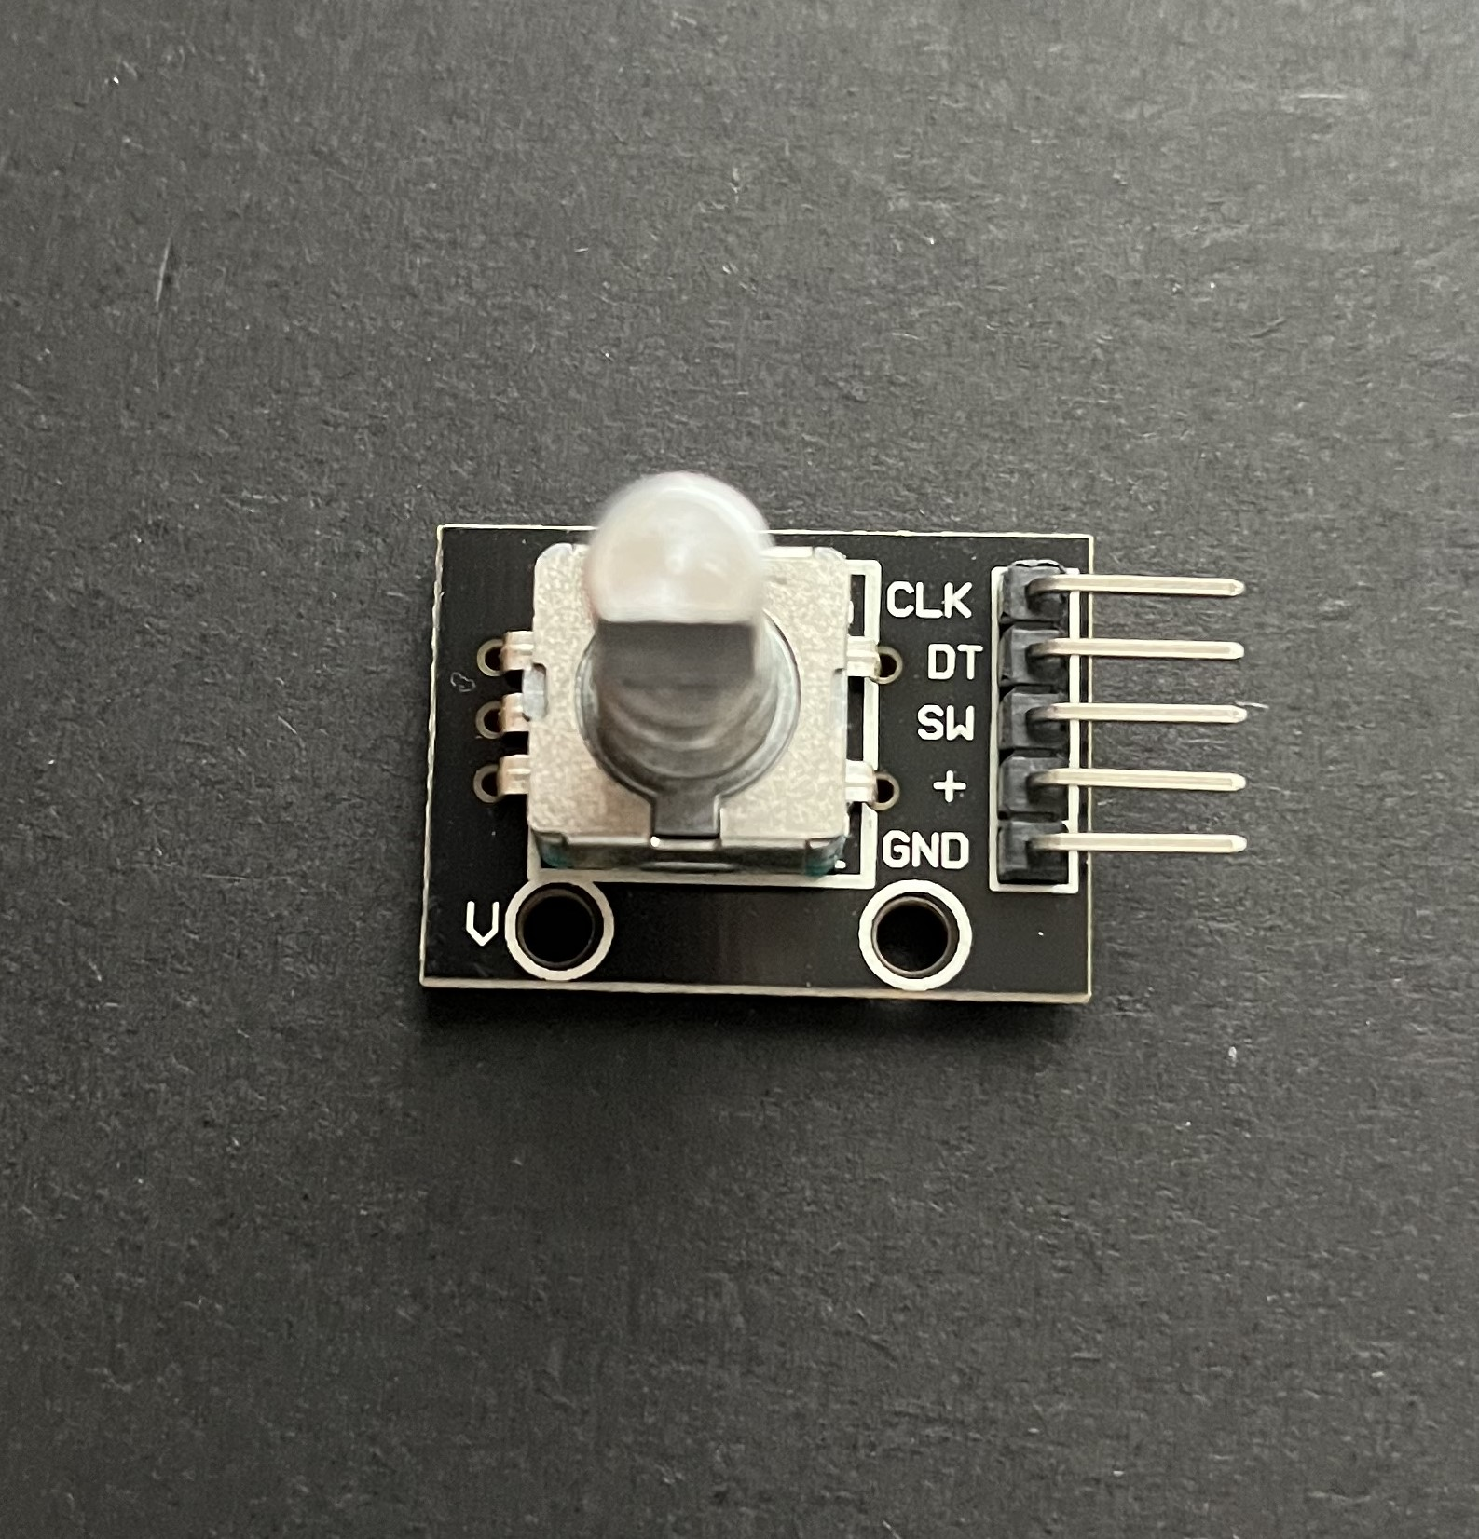
Rotary Encoder KY-040
The Principles of a Rotary Encoder
  A rotary encoder, as described, is an electromechanical device that converts the angular position and/or motion of a shaft (or axle) to an analog or digital output signal.
A rotary encoder allows your project to determine three specific things about a shaft or axle:
The direction is it turning (ex., clockwise, or counterclockwise).
The velocity (speed) at which it is turning (or if it is stationary).
Its position, specifically its angular position.

Slide 5
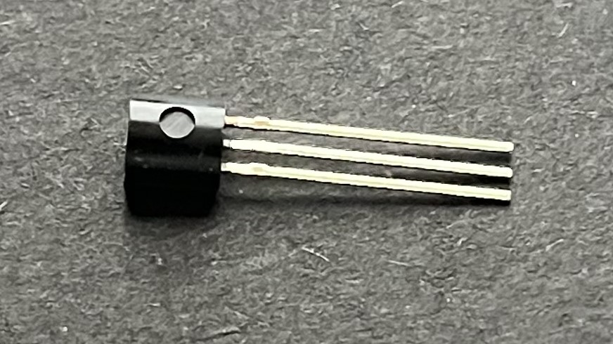
Hall Effect Sensor in ESP32
The working principles of the Hall Effect Sensor ESP32
A Hall effect sensor typically consists of:
A thin conductive plate (Hall element)
Power supply terminals
Magnetic field input
Output Terminals
When current flows through the conductive plate and a magnetic field is applied
perpendicular to the current, a voltage difference is generated
at the sides of the plate. This voltage is proportional
to the strength of the magnetic field.

Slide 6

Screenshots Tool
The Snipping Tool is a versatile software that allows you to save moments on your screen. The shape and form modes are good features that separate it from a typical screenshot. You have an option to choose what portion of the screen you would like to capture. The shape and form modes in the Snipping Tool serve as a solution to this. It allows you to select a small portion of the screen to capture in your preferred shape, depending on the mode.

Slide 7
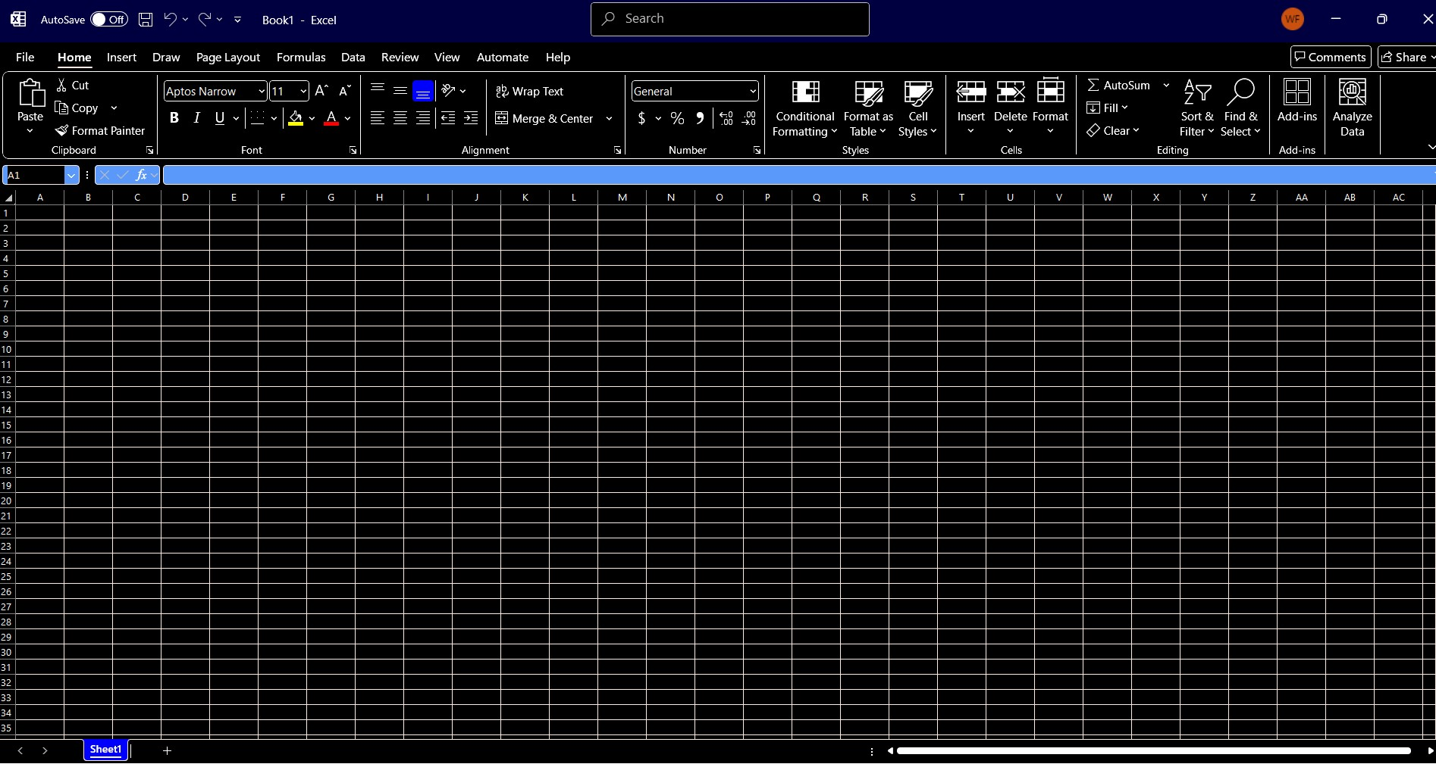
Required Software
Microsoft Excel

Slide 8
TECH204
Project Part 2
Precision of the Ultrasonic Sensor

Slide 9
Data Collection
Trial | Ruler Distance (cm) | Total Roundtrip Distance (m) | Time from Serial Monitor (microseconds) | Roundtrip time (s) | Velocity = distance/time (m/s)
1 | 8 | 0.16 | 492 | 4.92E-4 | 325
2 | 10 | 0.2 | 586 | 5.86E-4 | 341
3 | 15 | 0.3 | 925 | 9.25E-4 | 324
4 | 20 | 0.4 | 1187 | 1.187E-3 | 337
5 | 30 | 0.6 | 1724 | 1.724E-3 | 348
Ms. Watson’s

Slide 10
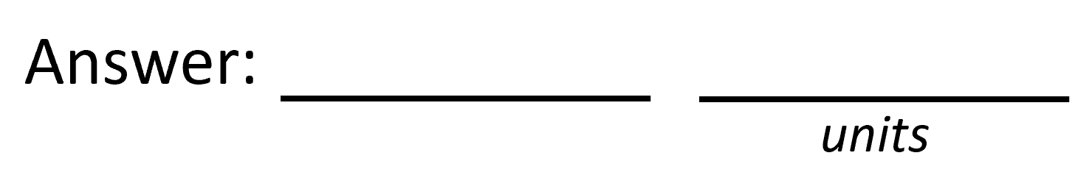

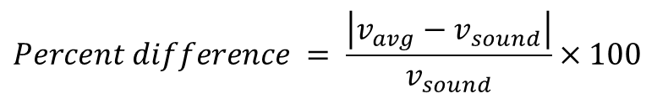

Data Analysis
  Average velocity from the table
Percent difference where $v_{sound}=343 m/s$
$$v_{avg}= \frac{v_{1}+v_{2}+v_{3}+v_{4}+v_{5}}{5}$$
335
m/s
$$Percent difference = \frac{\left|v_{avg}−v_{sound}\right|}{v_{sound}}×100$$
2.3
0/0

Slide 11
Conclusions
  Time of flight sensing
  As the distance between the ultrasonic sensor and the ruler increases, the time it takes for the ultrasonic wave to travel also increases.
  The velocity of the ultrasonic wave remains constant in -given medium unless the temperature or pressure changes.
The velocity of an ultrasonic echo is influenced by external environmental parameters like temperature, humidity, and atmospheric pressure on the speed of sound. The sensing range decreases as the temperature increases.
Airborne debris, such as dust, can weaken the ultrasonic energy and alter the field of view of the sensor, which affects the results.

Slide 12

TECH204
Project Part 3
Gravitational Acceleration of a Free-Falling Object

Slide 13
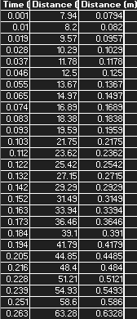
Excel Table

Slide 14
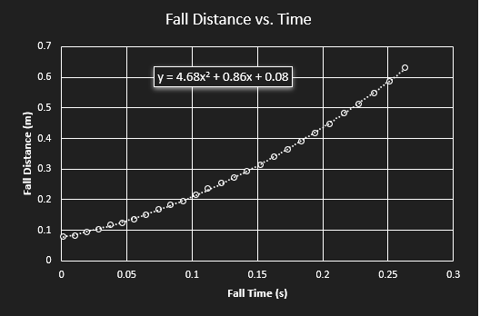
Excel Graph by Ms. Watson
Excel graph for a single trial showing the fall distance as a function of time.
Confirm that most data points fall along the curve fitting.
The x² coefficient should be between 2.5 and 7.5 such that it yields an acceleration value between 5 m/s² and 15 m/s²

Slide 15
Data Collection
Trial | x² coefficient value from curve fitting | Acceleration (m/s²) = 2* (x² coefficient)
1 | 4.86 | 9.36 m/s^2
2 | 5.02 | 10.04 m/s^2
3 | 4.66 | 9.32 m/s^2
4 | 4.62 | 9.24 m/s^2
5 | 4.73 | 9.44 m/s^2
By Ms. Watson

Slide 16

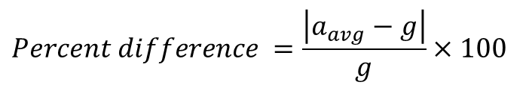
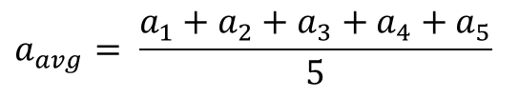
Data Analysis
Average acceleration from table
Percent difference with $g=9.8 m/s^{2}$
$$a_{avg}= \frac{a_{1}+a_{2}+a_{3}+a_{4}+a_{5}}{5}$$
9.48
m/s^2
$$Percent difference =\frac{\left|a_{avg}−g\right|}{g}×100$$
3.26
%

Slide 17
Conclusions
The variation in the acceleration values is what we use to calculate the mean and the standard deviation of the five measured values. This estimated value provides a quantitative measure of how much each value differs from the mean and serves as a direct indicator of the experimental uncertainty due to random errors. A lesser standard deviation means less variation and more precise results. But a higher value will indicate greater uncertainty.
There are some differences from trial to trial: the standard deviation is 0.32 m/s². Indicating the uncertainty in the result is approximately ±0.32 m/s². This refers to the measured acceleration to be 9.48±0.32 m/s². This quantifies the experimental precision.

Slide 18
TECH204
Project Part 4
Conservation of Energy of a Free-Falling Object

Slide 19
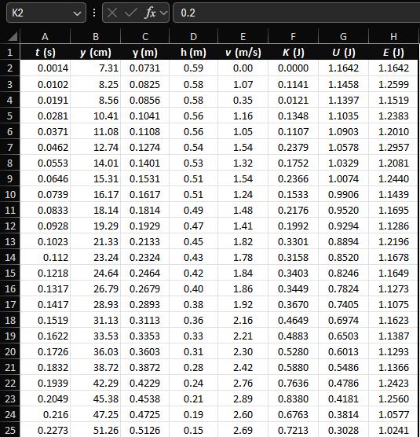
Excel Table
  Including all values in the Excel table for a single trial showing the fall distance in centimeters and meters as a function of time, with the values generated for kinetic energy K, potential energy U, and total mechanical energy E.

Slide 20
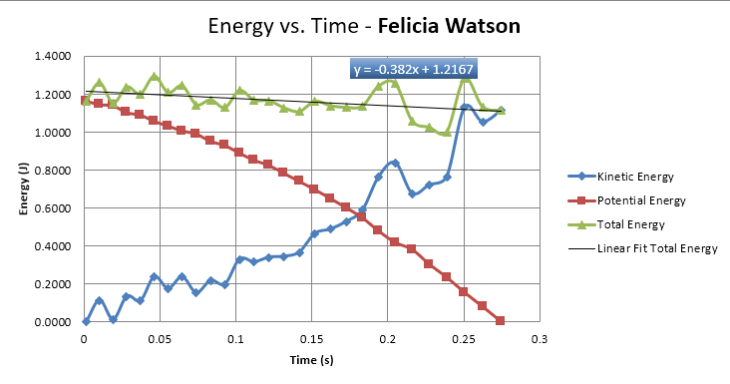
Excel Graph
Excel graph for a single trial showing the plots of the kinetic energy K, potential energy U, and total mechanical energy E as a function of time.

Slide 21

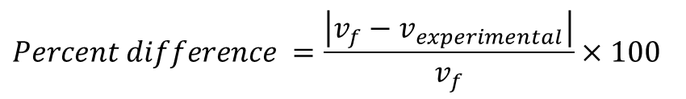


Data Analysis
Theoretical value of final velocity
Final velocity from experimental data (or largest velocity)
Percent difference
$h=y_{final}−y_{initial}=$
0.6671-0.0731
m/s
$v_{f}=\sqrt{2gh}=$
3.41
m/s
$v_{experimental}$ =
3.34
m/s
$$Percent difference =\frac{\left|v_{f}−v_{experimental}\right|}{v_{f}}×100$$
2.1
0/0

Slide 22
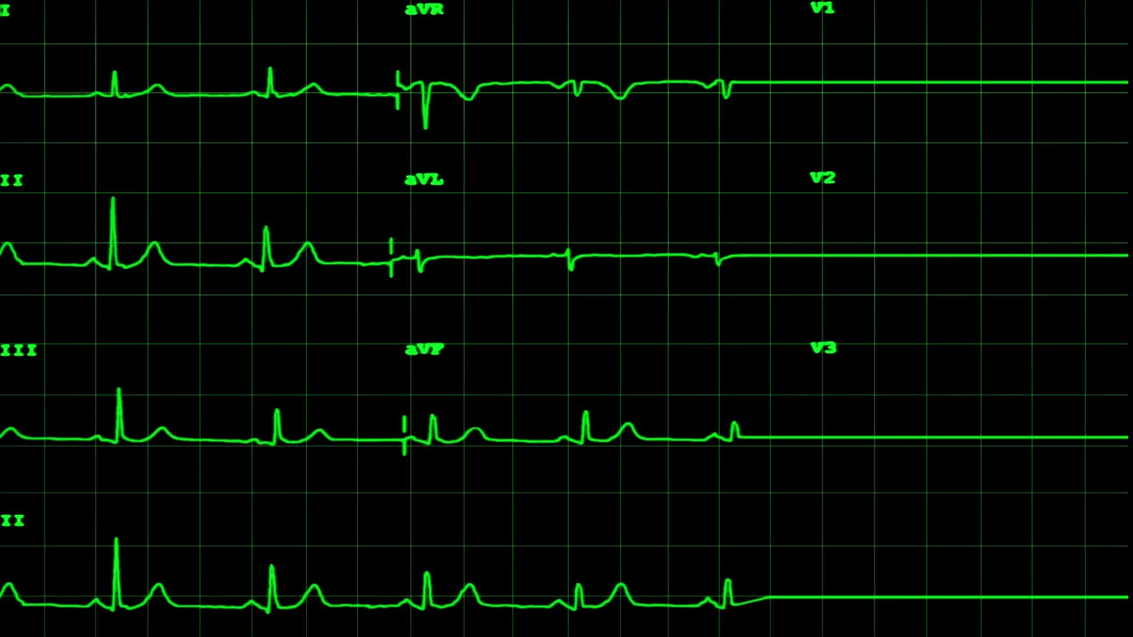
Conclusions
  This graph shows that while kinetic and potential energies exchange with each other, the total mechanical energy decreases over time. time. It is also displaying how the kinetic energy, potential energy, and total energy of this system change over time during this experiment. According to the law of conservation of energy, the total energy in a closed system should remain constant unless energy is lost. The linear fit of total energy helps to quantify whether total energy is, in fact, conserved or if there is a noticeable gain or loss over time, as shown by the slope.

Slide 23
Conclusions
The best-fit line for total energy E shows a slight decrease as time progresses. The slope is slightly negative because it shows a small, gradual loss of total energy over time.
The data collected is showing a decrease. Because it converts a portion of mechanical energy into other forms like heat or sound. These conversion portions can’t be accounted for in the measurement of mechanical energy.
Because the total mechanical energy of this system measured in this experiment decreases slightly, it manifests as a downward-sloping best-fit line in this data.

Slide 24
TECH204
Project Part 5
Relationship between Linear and Rotational Motion

Slide 25
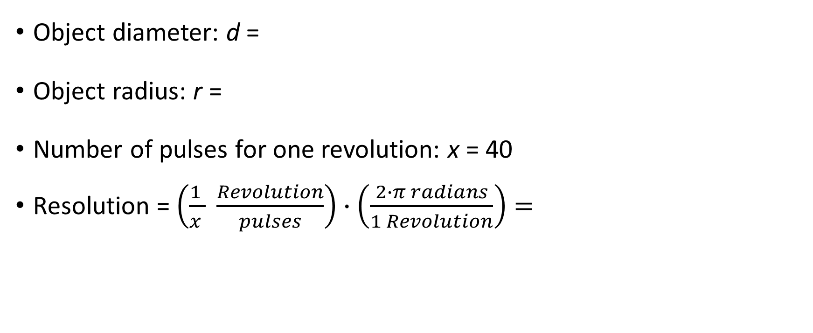
Data Collection
Object diameter: d =
Object radius: r =
Number of pulses for one revolution: x = 40
Resolution = $\left(\frac{1 }{x } \frac{Revolution}{pulses}\right)∙\left(\frac{2∙π radians}{1 Revolution}\right)=$
7
cm
3.5
cm
40
0.157
Radius per pulse

Slide 26
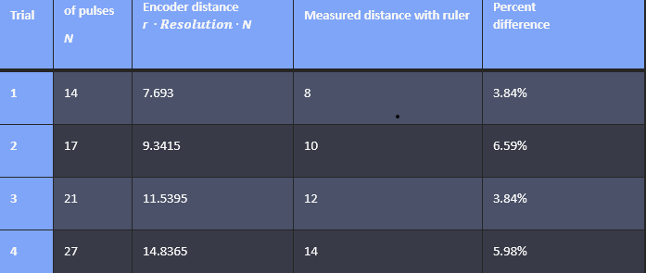
Data Analysis

Slide 27
Conclusions
Briefly describe and explain the results.
  Answer:
  This is the calculated answer of a rotational system. It’s based on the given object’s dimensions and the pulse count per revolution
What are some applications of this measuring technique? Could this measuring system be used to measure surfaces that are not flat?
  Answer: The sensor used impacts the resolution. Different types of technology have different capabilities and limitations in detecting angular change. I think that this measuring system can be used to measure systems that aren’t flat.

Slide 28
TECH204
Project Part 6
Observing the Hall Effect

Slide 29
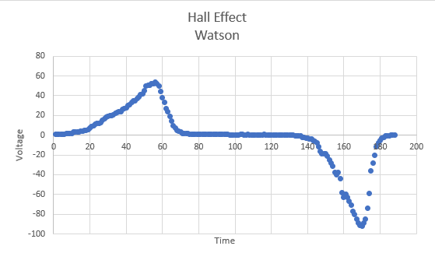
Excel Graph
Excel graph for a single trial of data plotted as a function of time.

Slide 30

Conclusions
This Graph demonstrates how Hall voltage responds to the changes in magnetic field/current direction.
There is a steady rise in the voltage when the field is applied in one direction, and the voltage drops fast to the base line when off or constant. Forming a negative trough when reserved. Then it recovers toward zero.
Hall Effect sensors are an essential component in modern electronics and electromechanical systems. They are widely used to detect the presence of a magnetic field and to measure its strength, position, and polarity.
The Hall sensor works. When a magnetic field is applied perpendicular to the flow of current in a conductor or semiconductor, it causes a Lorentz force that deflects charge carriers to one side of the material. This accumulation of charges leads to a measurable voltage, known as the Hall voltage.
Some of the Hall Effect sensor applications are applied across a wide range of industries and technologies like Automotive, Industrial, consumer electronics and medical devices.

Slide 31

Challenges
The entire project was a challenge for me because it was a part of physics that I was aware of, but I didn’t know or understand the depth of this area of physics, or the math. Seeing the videos that were supplied with the assignments was insightful. But the part of mapping it all out on paper was my challenge. This was interesting and time-consuming, but I enjoyed the challenge.

Slide 32
Career skills that I have strengthened/utilized
This project has enriched my critical thinking skills. By breaking down multi-step challenges that included
Formulating hypotheses, data interpretation, estimating uncertainties, and extracting meaningful trends from noisy data.
I have also enriched my thought process of execution. These experiments and the trigonometry made paying attention to detail a must to obtain the correct outcome.
Time management was important because I had to plan my time for execution and meet the required due dates.

