Slide 1

The Process of Building an Intelligent Circuit of a Physical Home Security
Felicia Watson
Introduction to Technology and Information Systems
CEIS 101C
Instructor Mr. Darniet Jennings

Slide 2
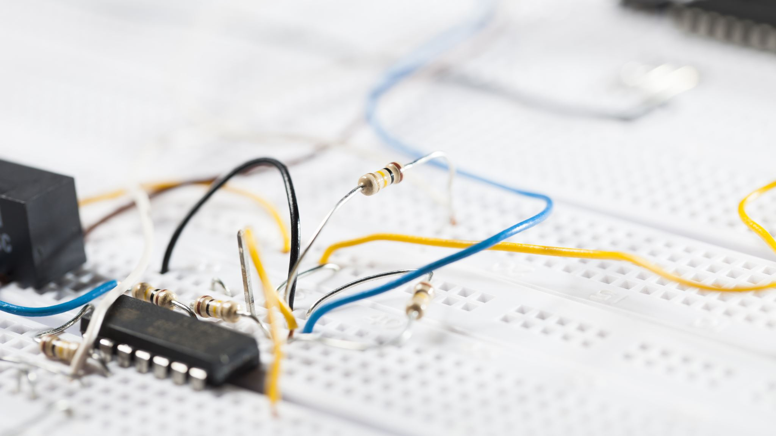
Introduction
In this project, an intelligent home security system has been built. This physical circuit was built in tinkercad and programmed in Arduino IDE. I was beginning with unassembled parts from the IoT Tech Core Kit. I utilized LEDs, initialized the serial monitor, programmed LEDs, and sent messages to the serial monitor. You will notice each process I have taken to enhance this intelligent home security system. I was showing the basics of the Internet of Things (IoT), computing, networking, and electronic devices that I have developed.

Slide 3

CEIS101
Module 2
Circuit Simulation in Tinkercad
Utilizing Tinkercad to build the circuit with Arduino Uno R3 and then programming the intelligent home security system. With block and text for the out and control for stimulation.

Slide 4
Rubric
IMPORTANT: You MUST include the title of your circuit design (shown under the Tinkercad logo) in the format of course number, session number, and your last name to receive credit.
Activity | Requirement(s) | Points
Building circuit | Screenshot of completed circuit in Tinkercad | 20
Programming | Screenshot of code in Tinkercad | 20

Slide 5
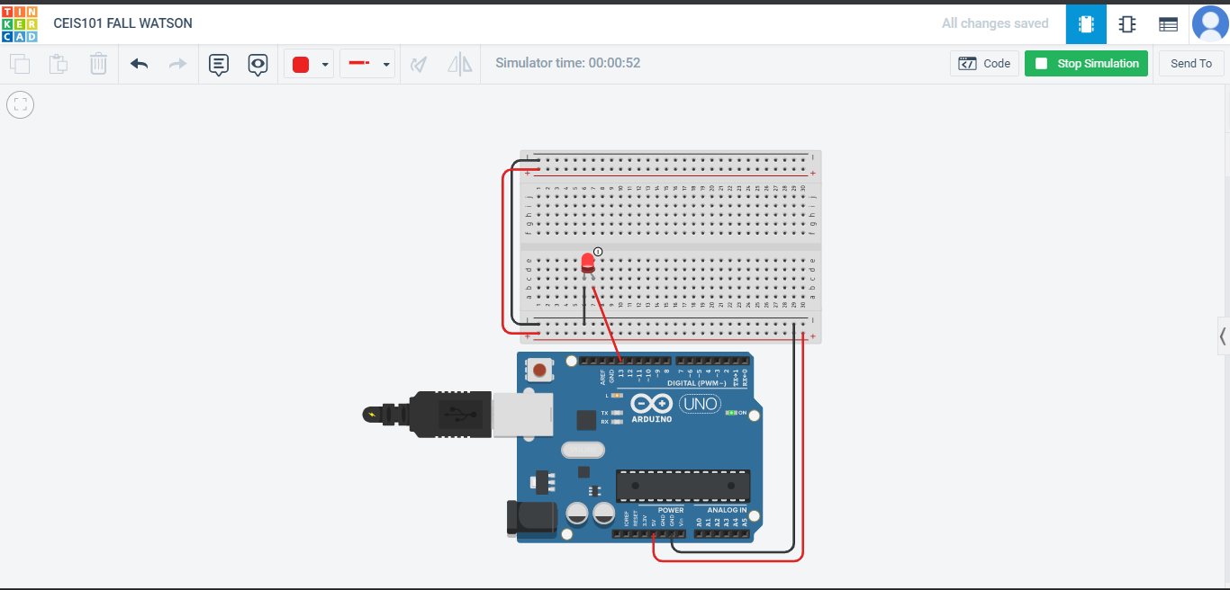
Circuit (screenshot)

Slide 6
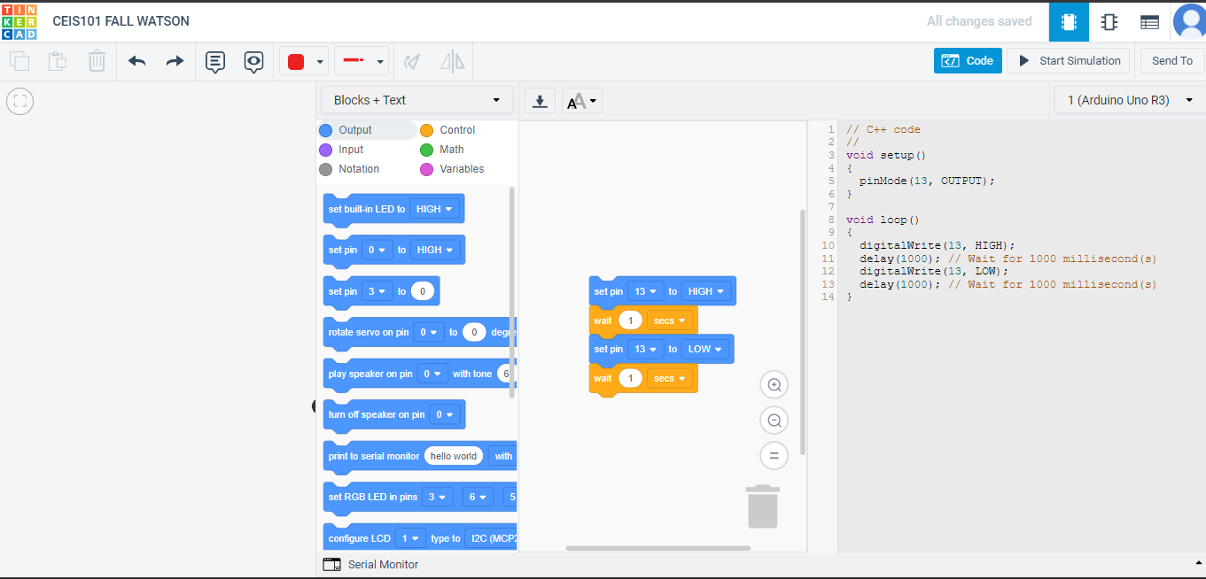
Code (screenshot)

Slide 7

CEIS101
Module 3
Inventory of all parts in the IoT Tech Core Kit Parts,
To successfully begin Circuit Building by displaying
messages utilizing Ardunio IDE.

Slide 8
Rubric
Activity | Requirement(s) | Points
Inventory of IoT Tech Core Kit | Picture of entire IoT kit | 5
Organization of components | Picture of required organization of components for course project | 15
Set up circuit | Picture of complete circuit with red LED on | 10
Run code | Screenshot of Serial Monitor showing your name and the messages that the LED is on/off | 10

Slide 9
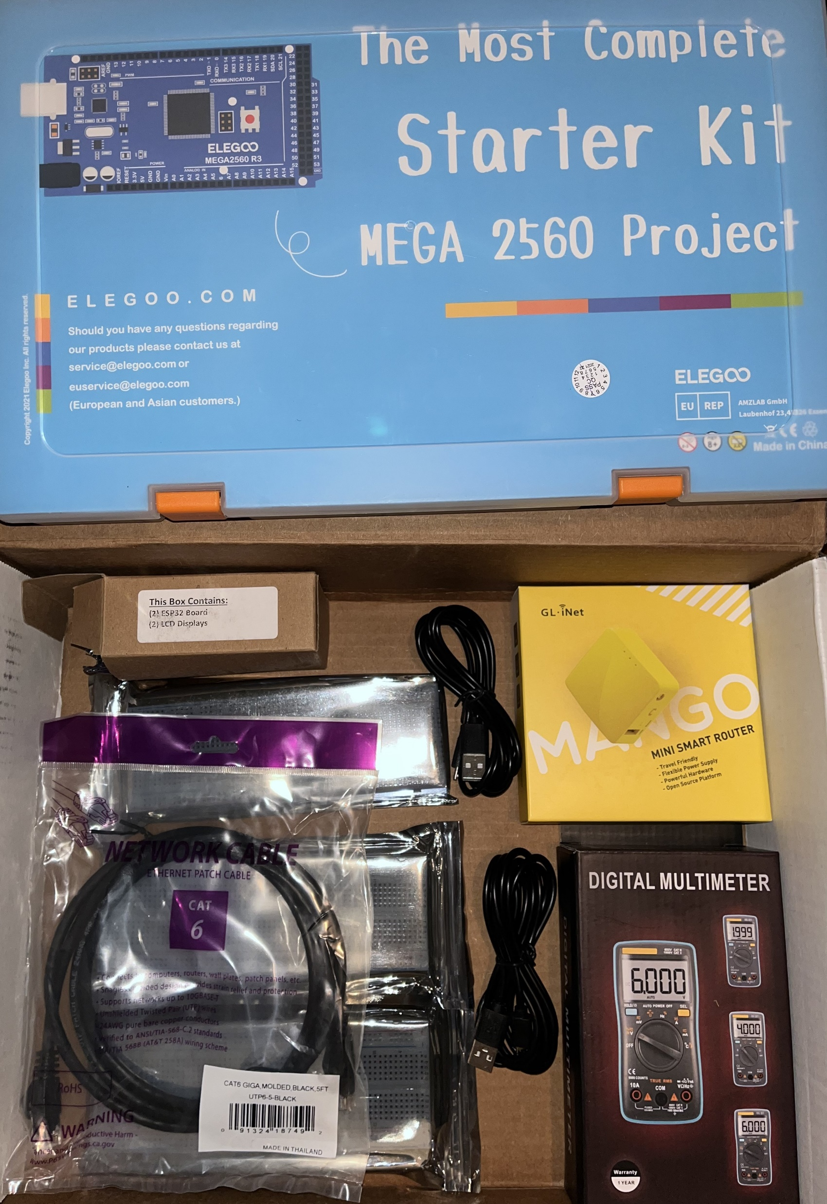
Inventory of IoT Kit (picture)
UCTRONICS Kit
ESP32 (2)
LCD Modules (2)
Breadboards (3)
Mini Router
Patch Cable
Digital Multi Meter
USB to Micro USB (2)

Slide 10
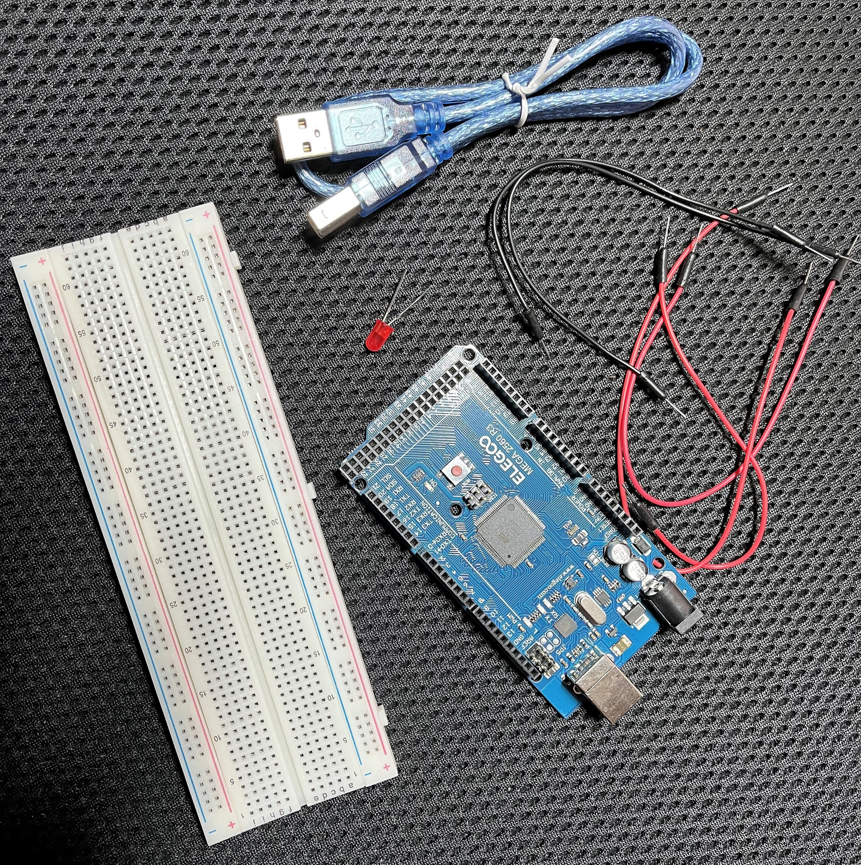
Organization of Project Components (picture)
Arduino Mega 2560
Breadboard
LED
Wires
USB Type B cable

Slide 11
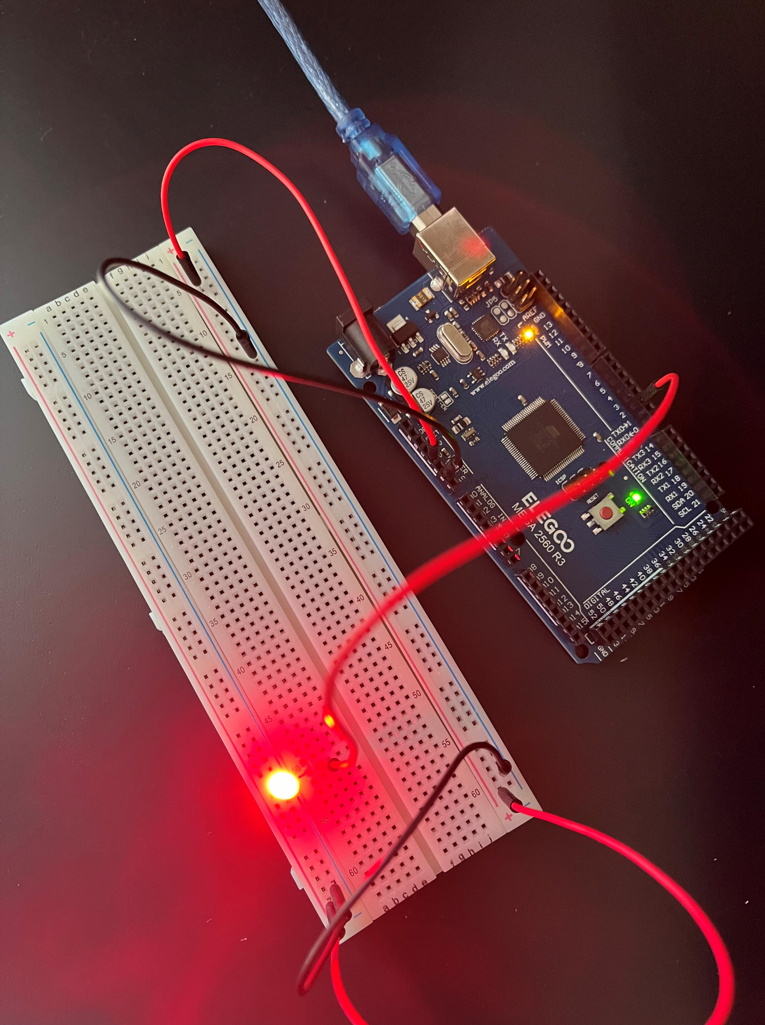
Circuit with red LED on (picture)

Slide 12
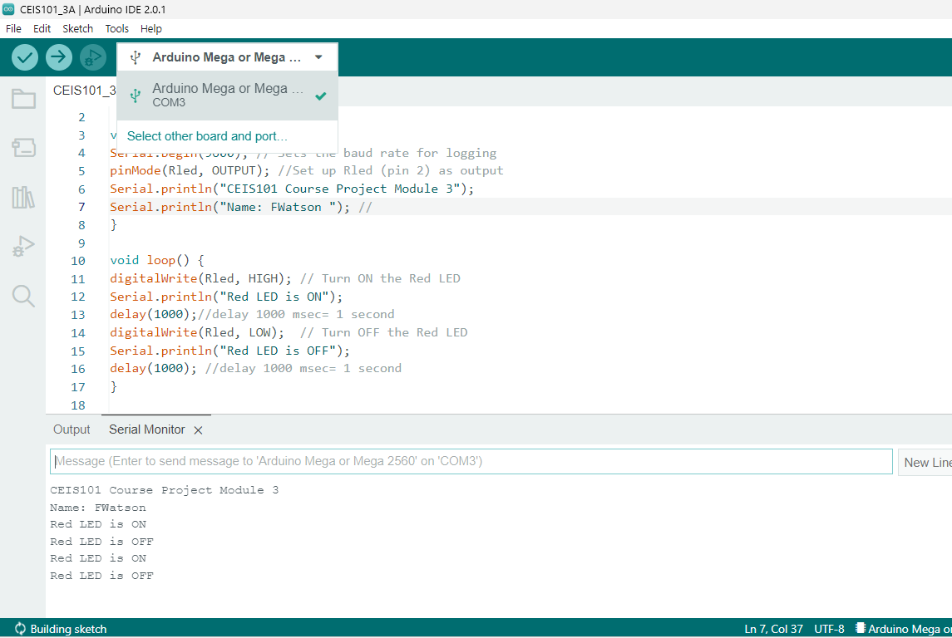
Serial
Monitor
(screenshot)

Slide 13
CEIS101
Module 4
Enhancing this intelligent home system by Adding a Door Sensor. Displaying the Outcome of a door open/closed.

Slide 14
Rubric
Activity | Requirement(s) | Points
Set up circuit | Picture of circuit with green LED on (door closed) | 10
Set up circuit | Picture of circuit with red and yellow LEDs on (door open) | 20
Upload code | Screenshot of code in Arduino IDE with your name shown | 10
Run code | Screenshot of serial monitor with your name and messages shown | 20

Slide 15
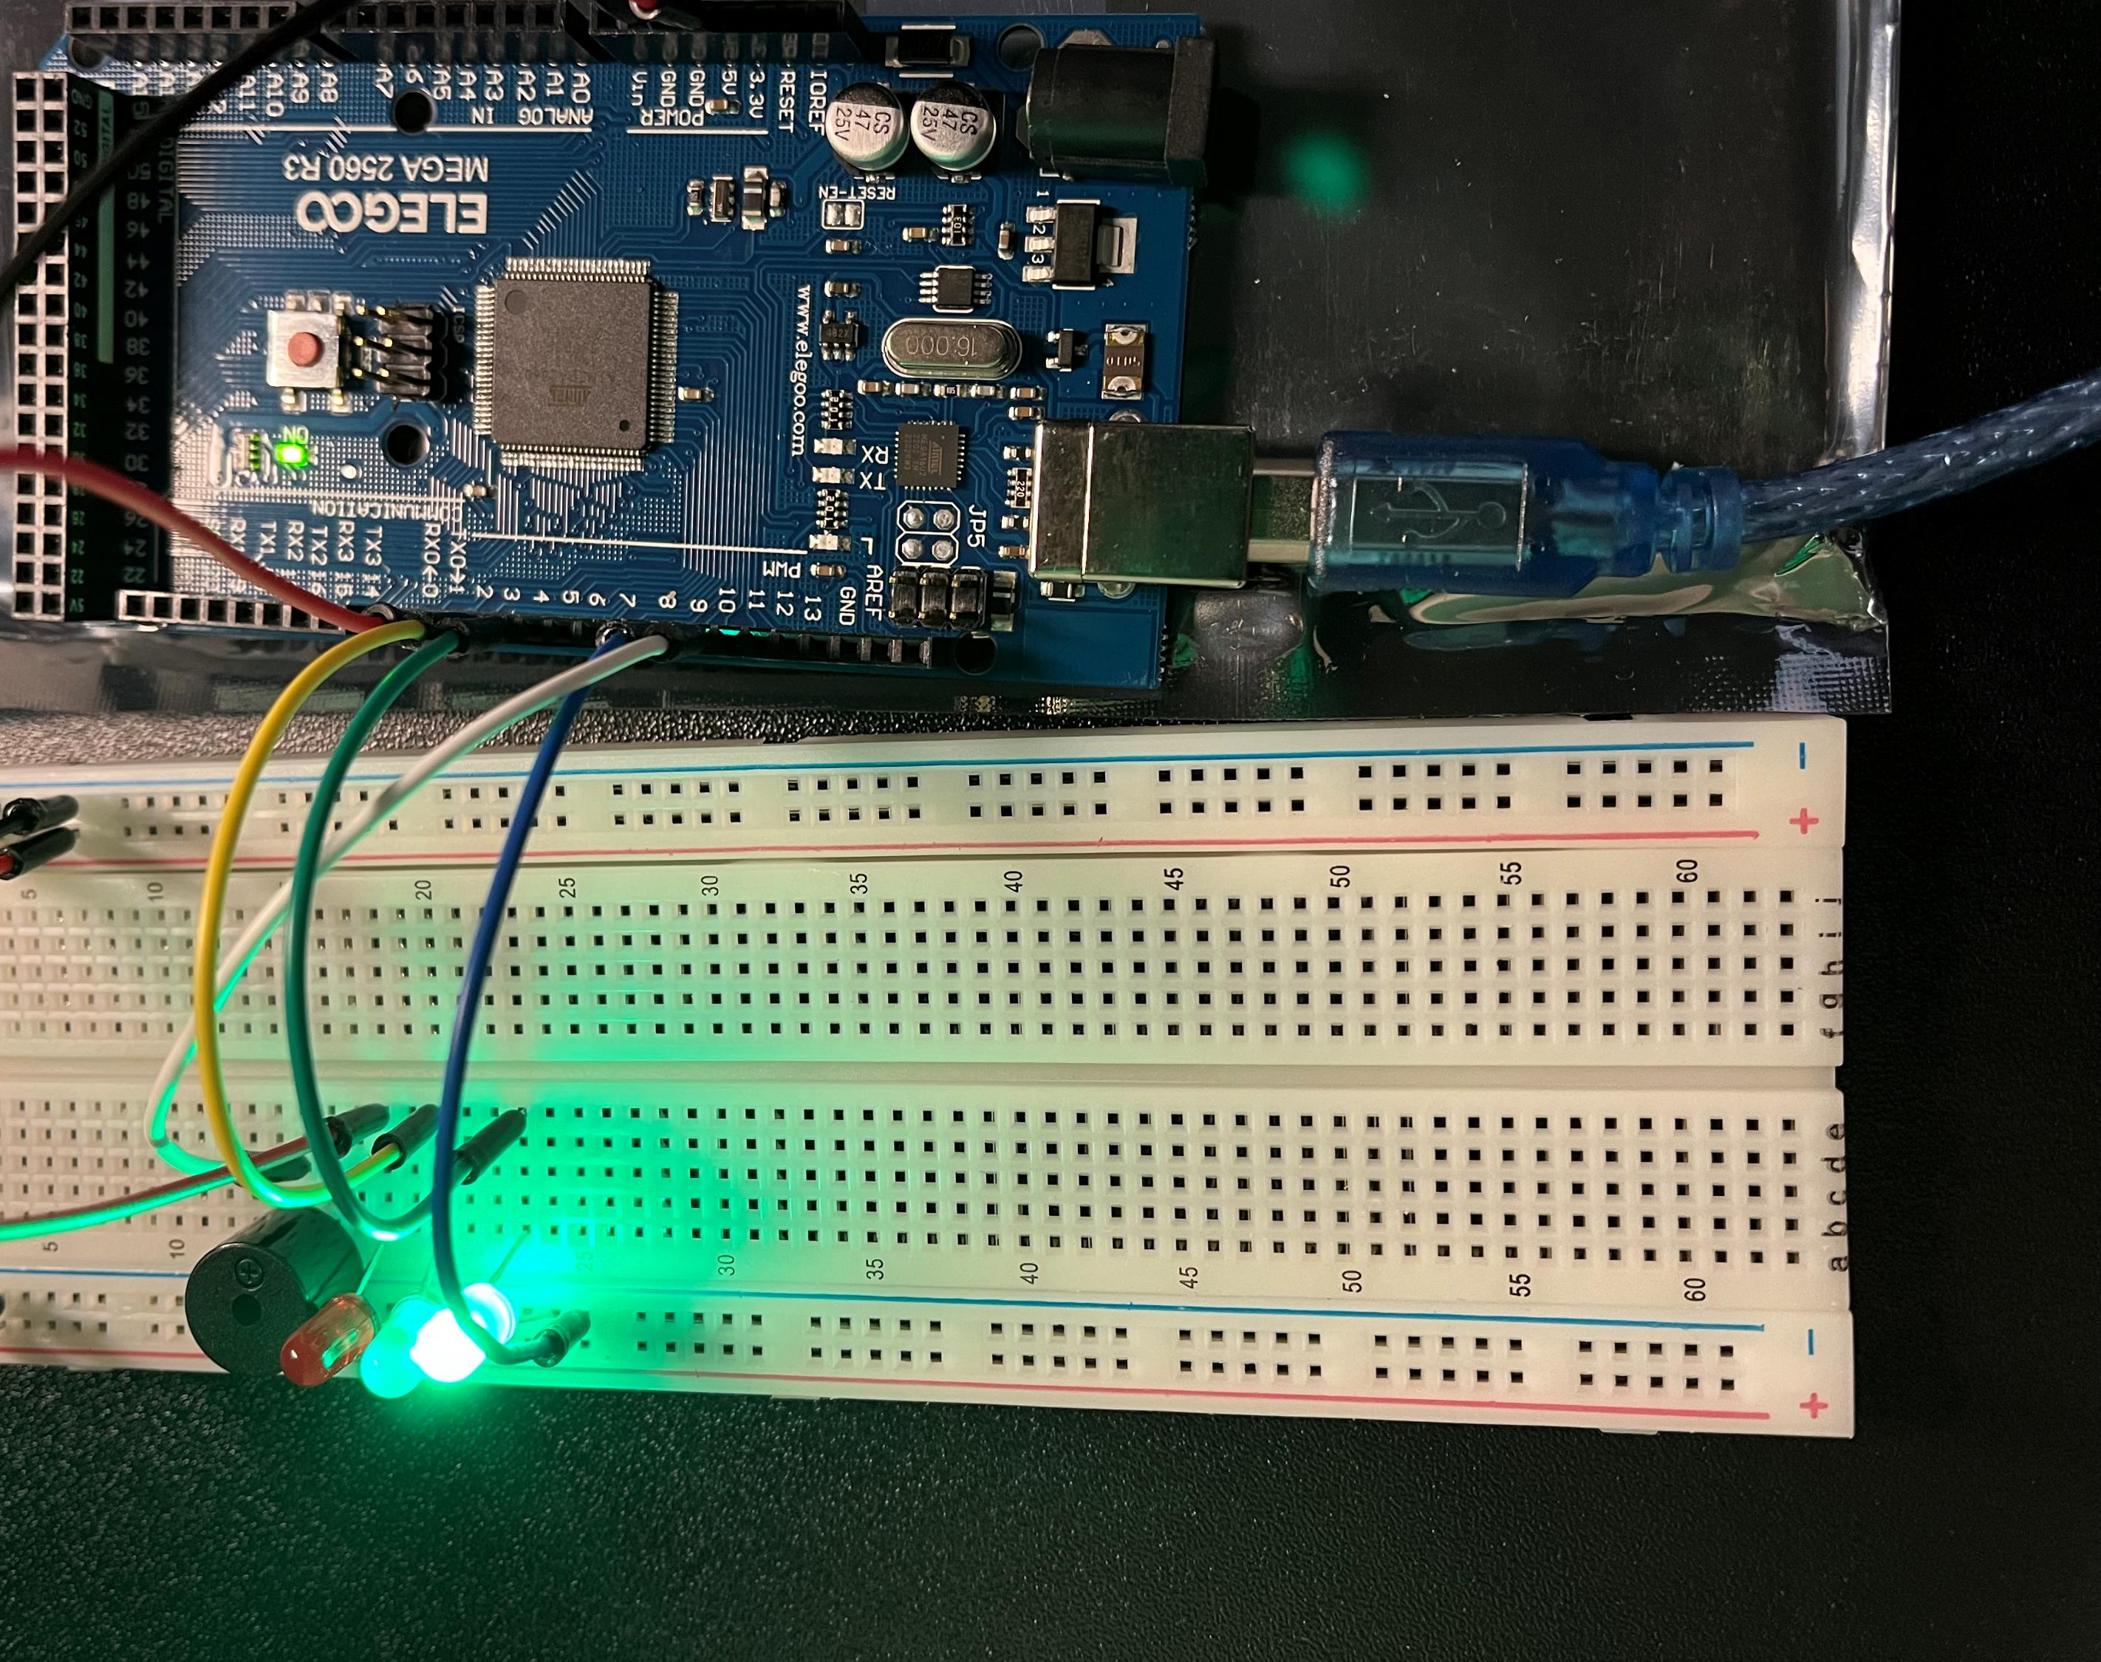
Circuit of door closed with Green LED ON (picture)

Slide 16
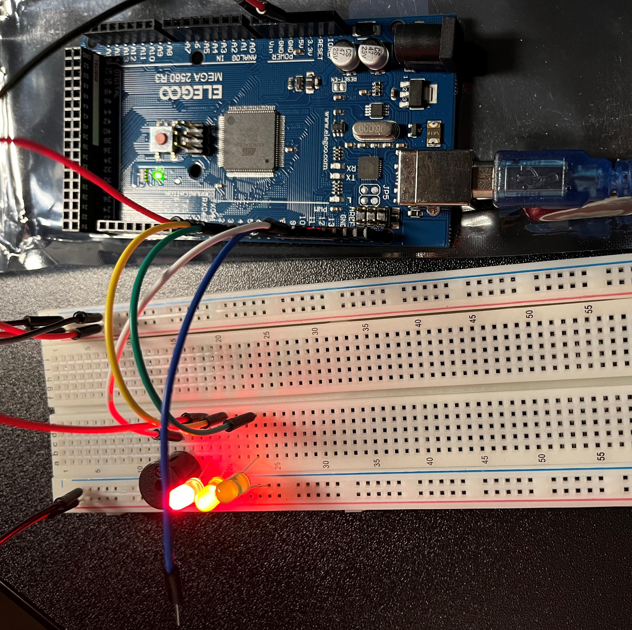
Circuit of door open with
Green LED OFF
(picture)

Slide 17
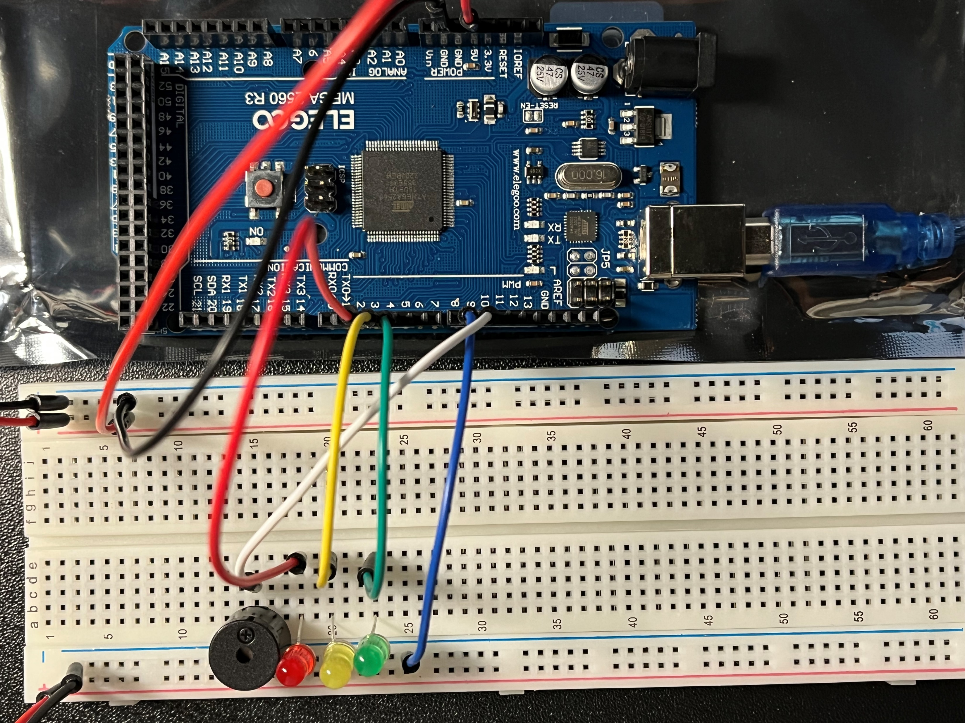
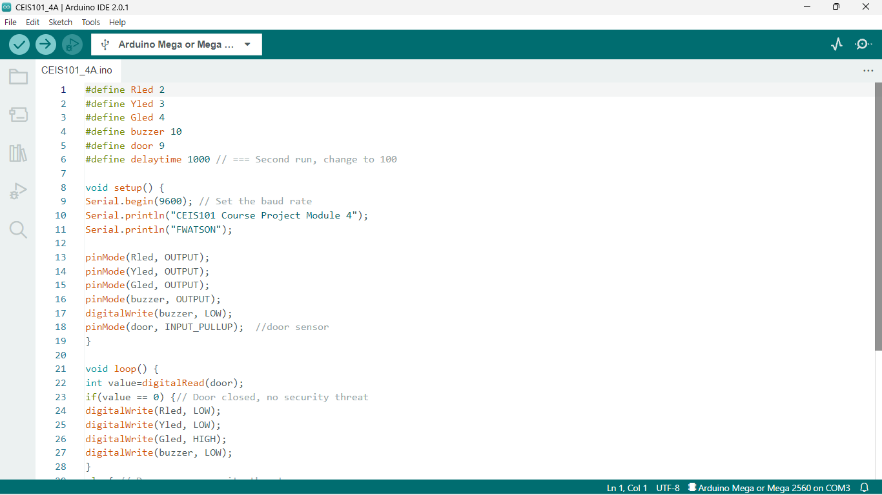
Arduino Code (screenshot)

Slide 18
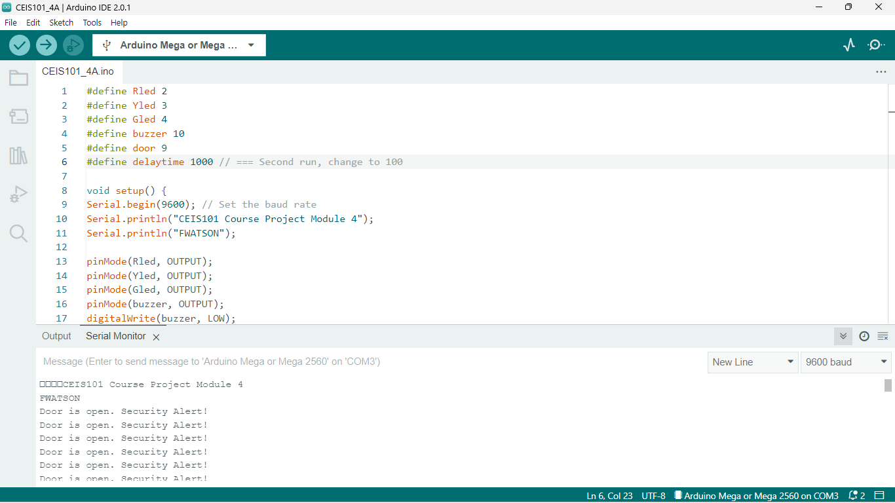
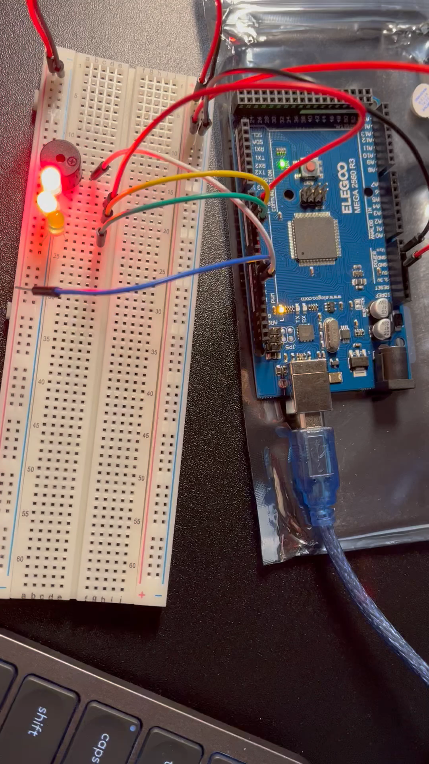
Serial Monitor (screenshot)
Notes:
This is a circuit built with an alarm going off with the door open. The delay time for the alarm is set at 1000.

Slide 19

CEIS101
Module 5
A Distance Sensor is added to this Intelligent Home System. Doing this show the level of sensitivity within range. The code is uploaded to Arduino Ide to conduct data analysis.

Slide 20
Rubric
Activity | Requirement(s) | Points
Set up circuit | Picture of circuit with green LED on | 5
Set up circuit | Picture of circuit with yellow LED on | 5
Set up circuit | Picture of circuit with red LED on | 5
Upload code | Screenshot of code in Arduino IDE with your name shown | 15
Analyze data | Excel plot of data generated by distance sensor | 30

Slide 21
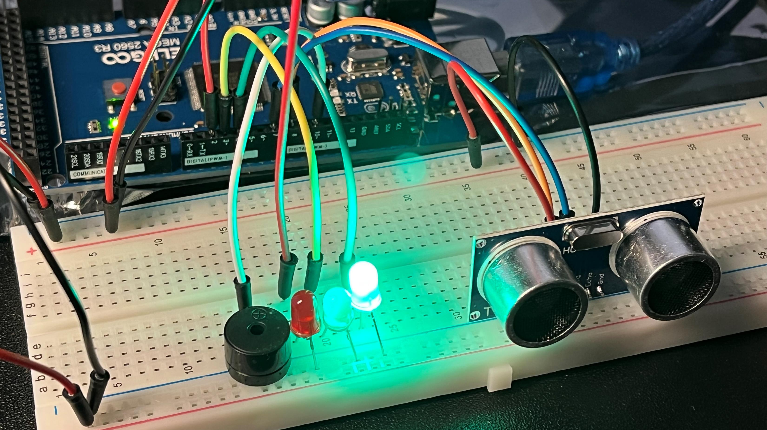
Circuit with green LED on (picture)

Slide 22
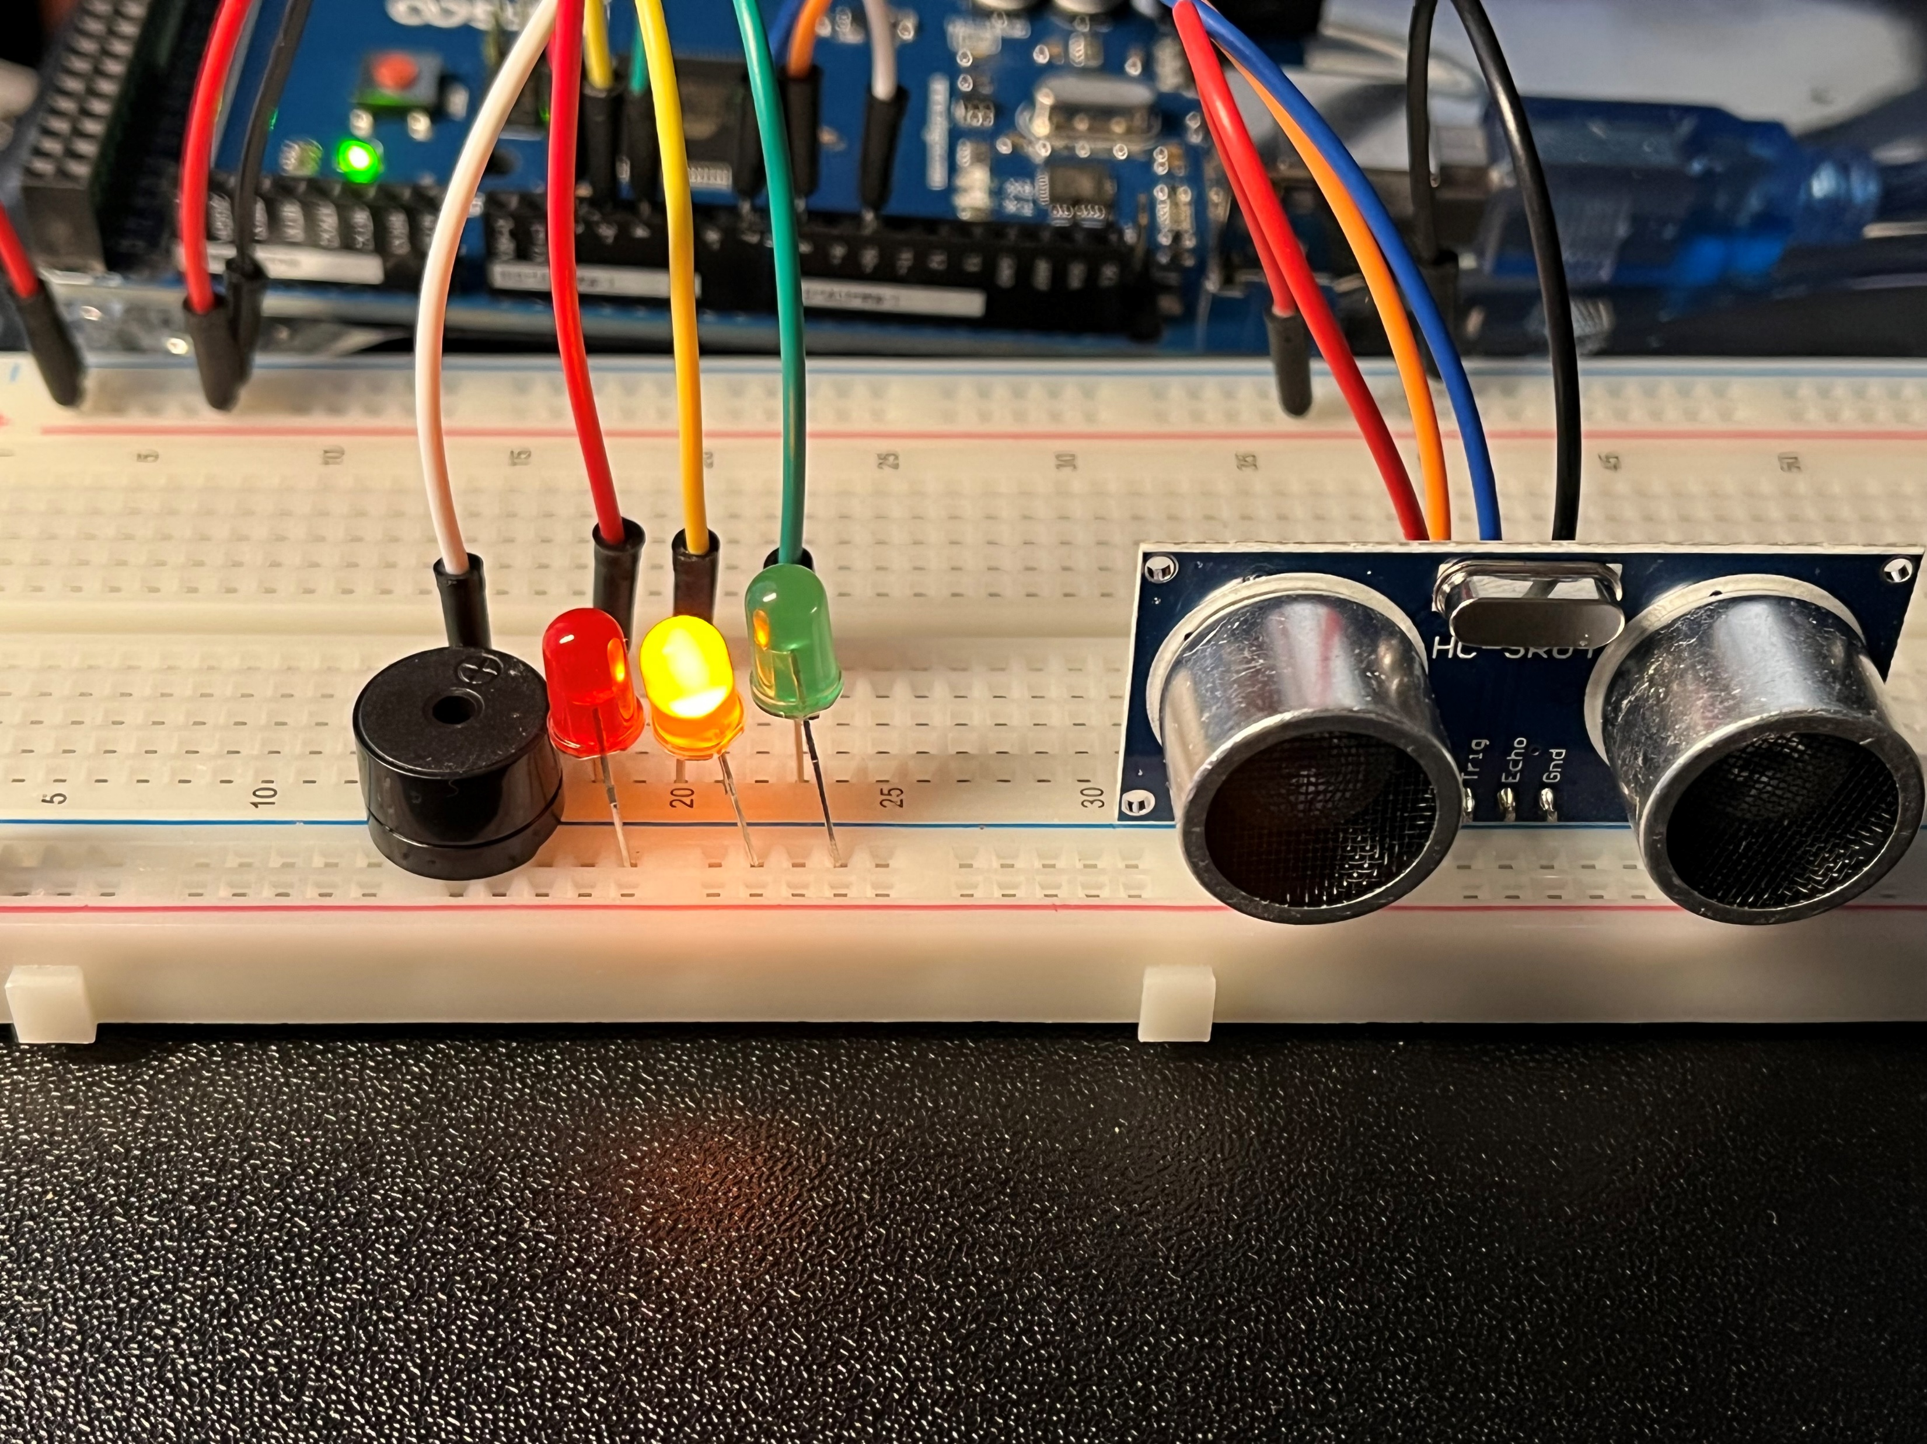
Circuit with yellow LED on (picture)

Slide 23
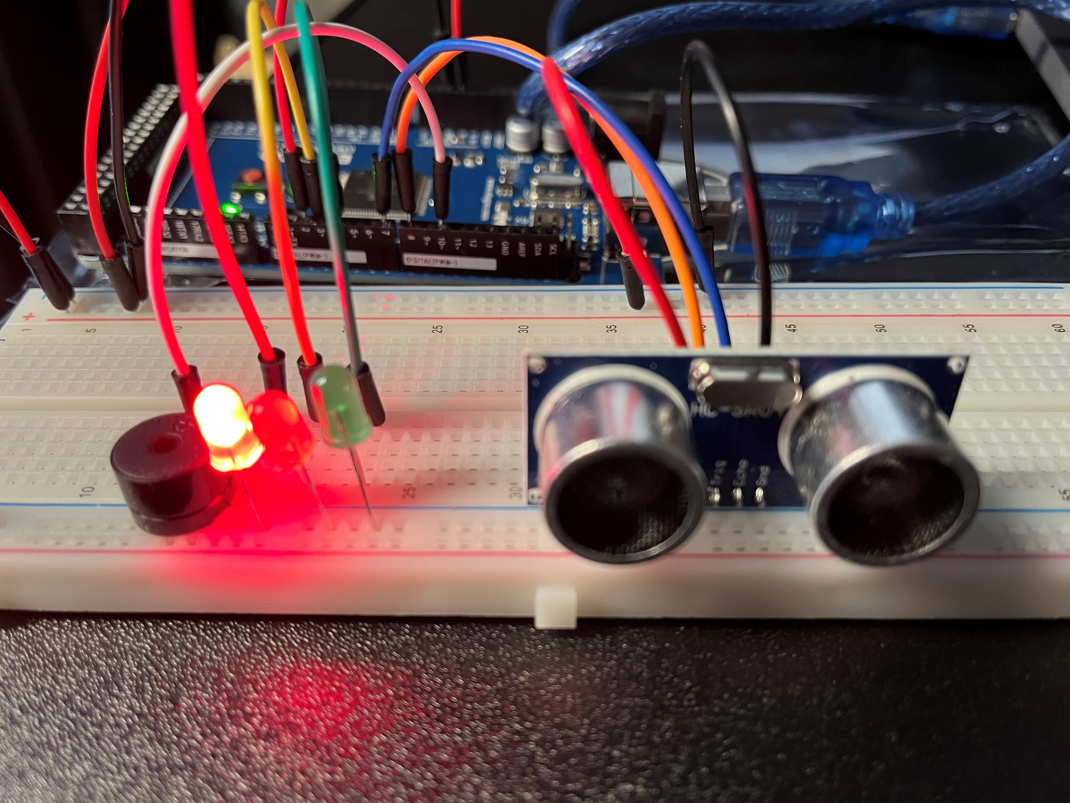
Circuit with red LED on (picture)

Slide 24
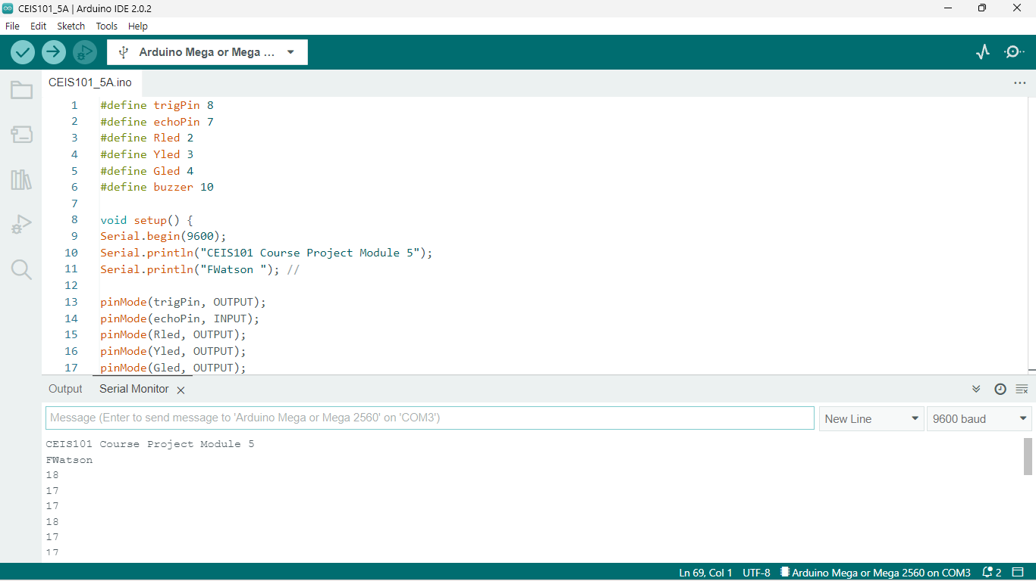
Arduino Code (screenshot)

Slide 25
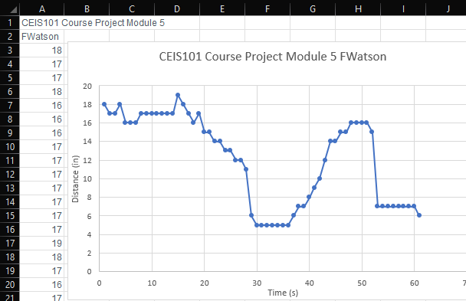
Plot of data (graph from Excel)

Slide 26
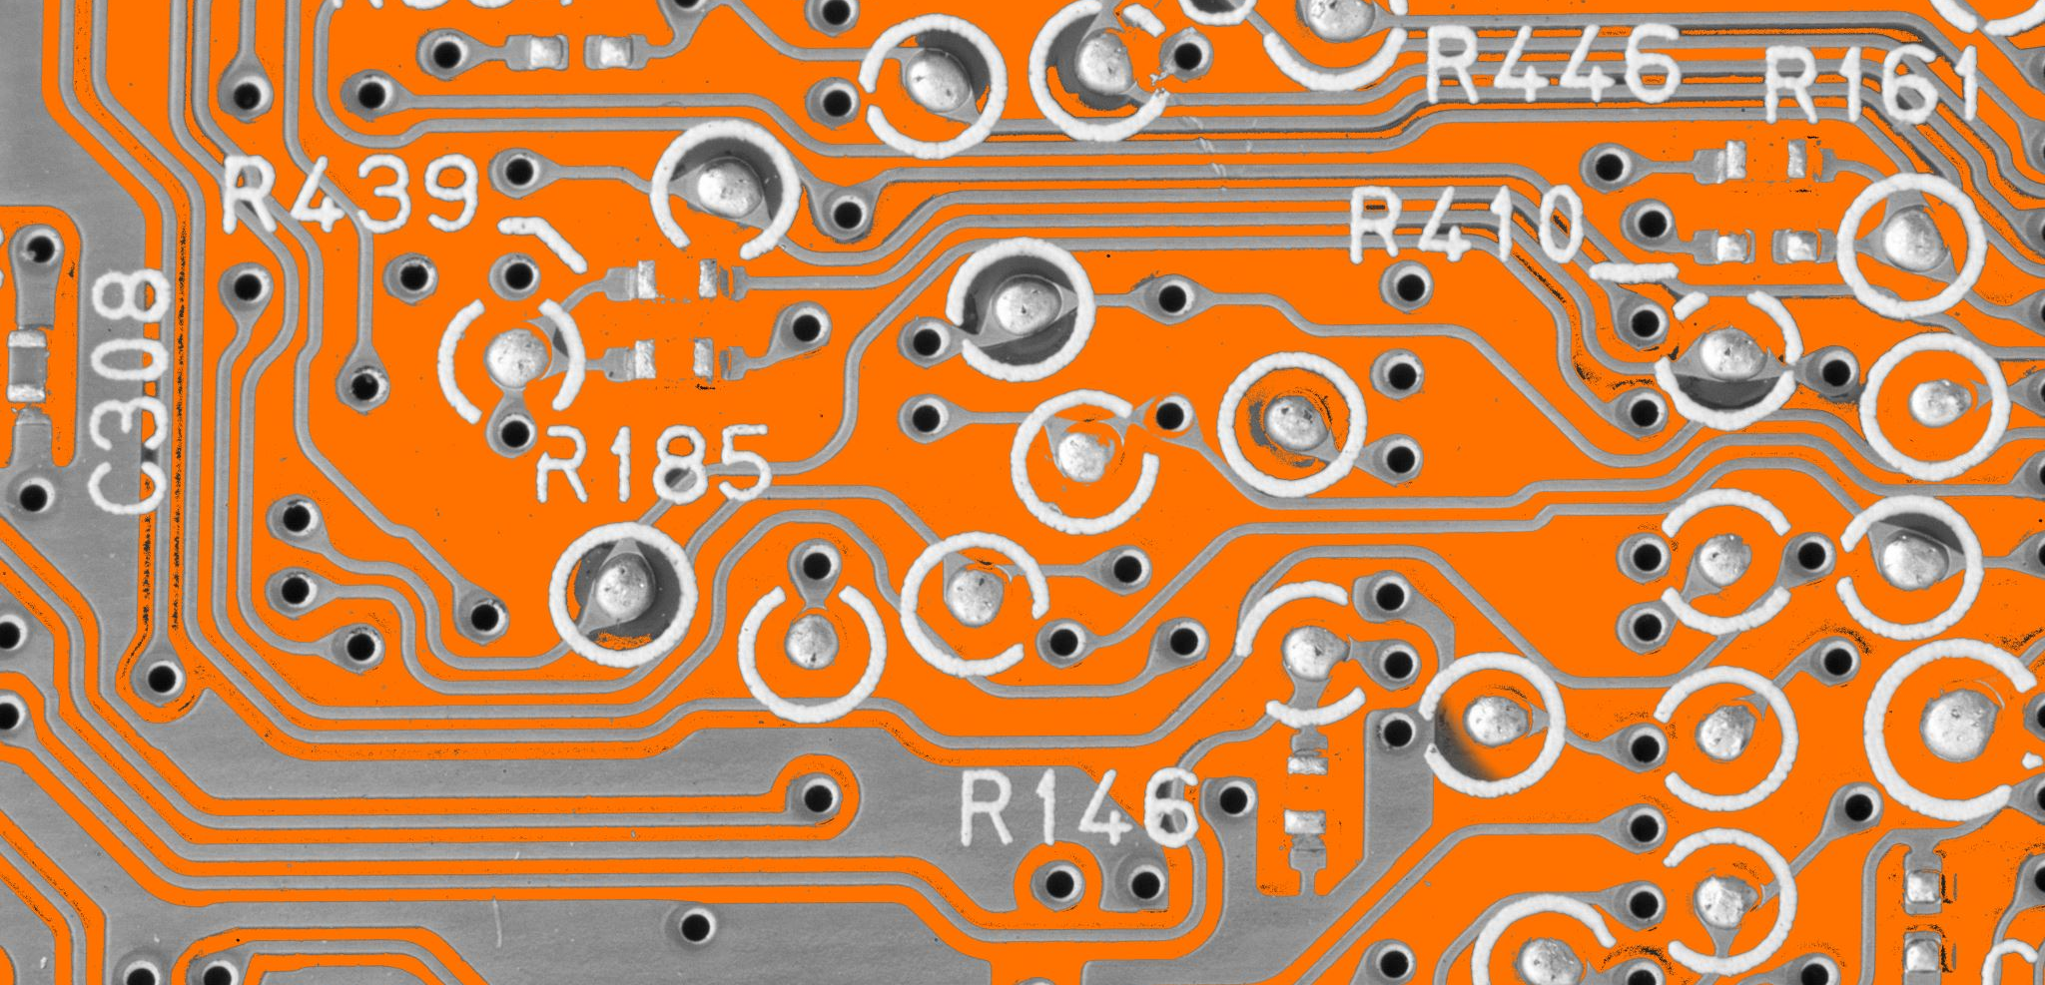
CEIS101
Module 6
Completing this Intelligent Home System with the addition of Automated Light. Enhanced to show the led outcome of an armed system with the results of an intruder.

Slide 27
Rubric
Activity | Requirement(s) | Points
Set up circuit | Picture of complete circuit with automated LED off | 10
Set up circuit | Picture of complete circuit with automated LED on | 20
Upload code | Screenshot of code in Arduino IDE with your name shown | 10
Run code | Screenshot of Serial Monitor with your name and messages shown | 20

Slide 28
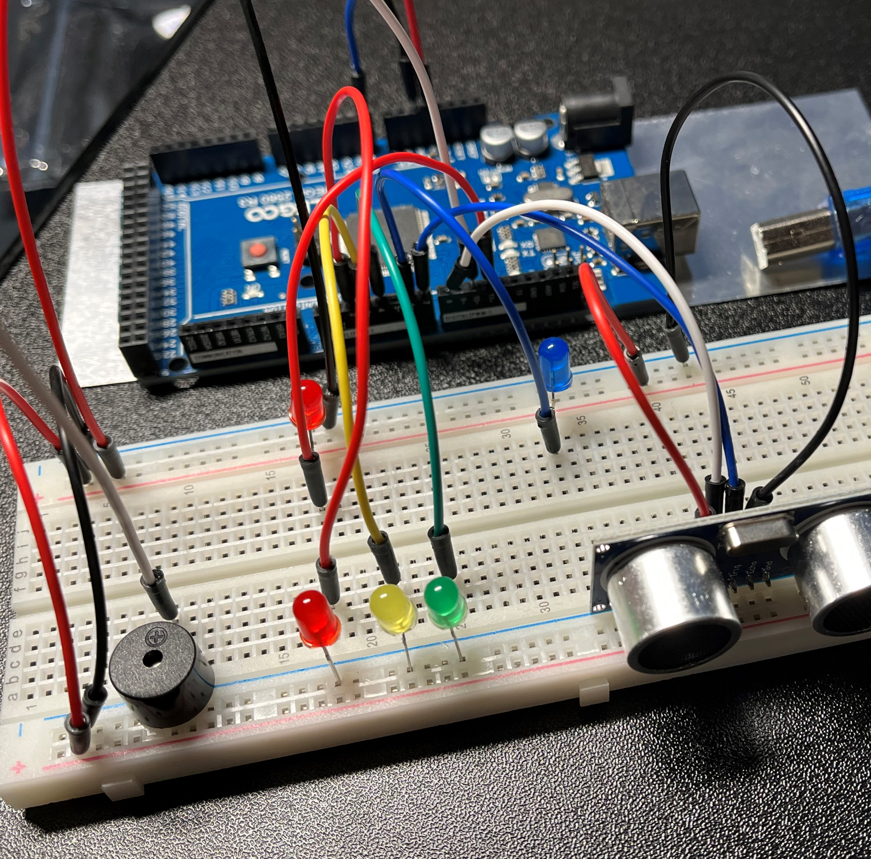
Circuit with automated LED off (picture)

Slide 29
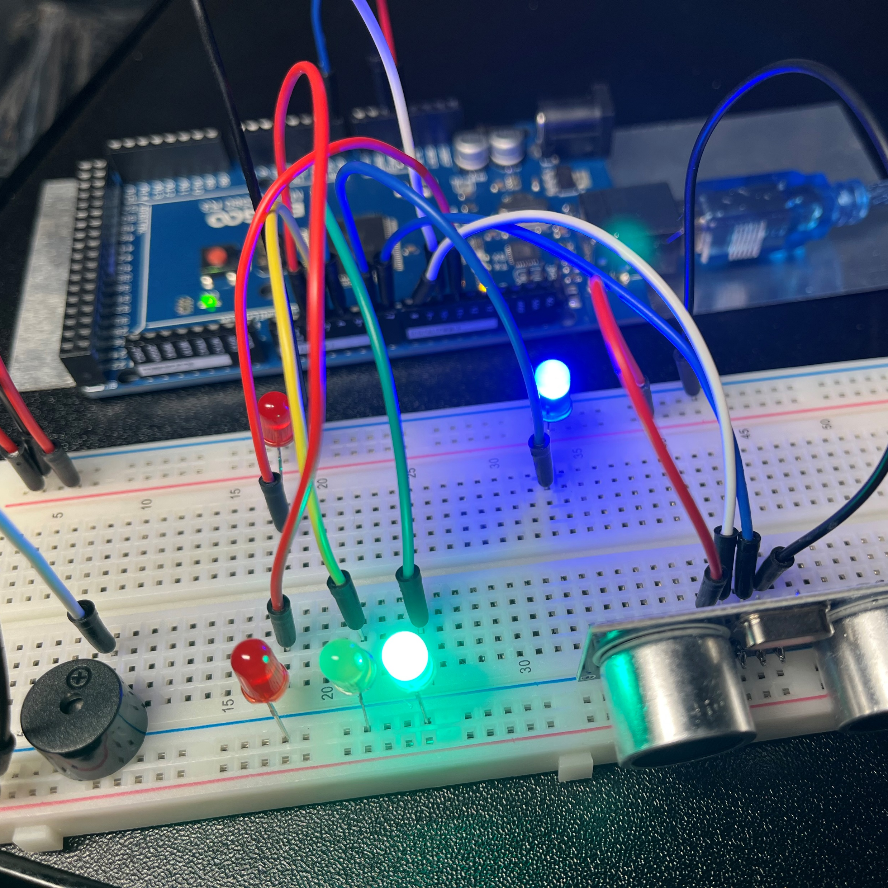
Circuit with automated LED on (picture)

Slide 30
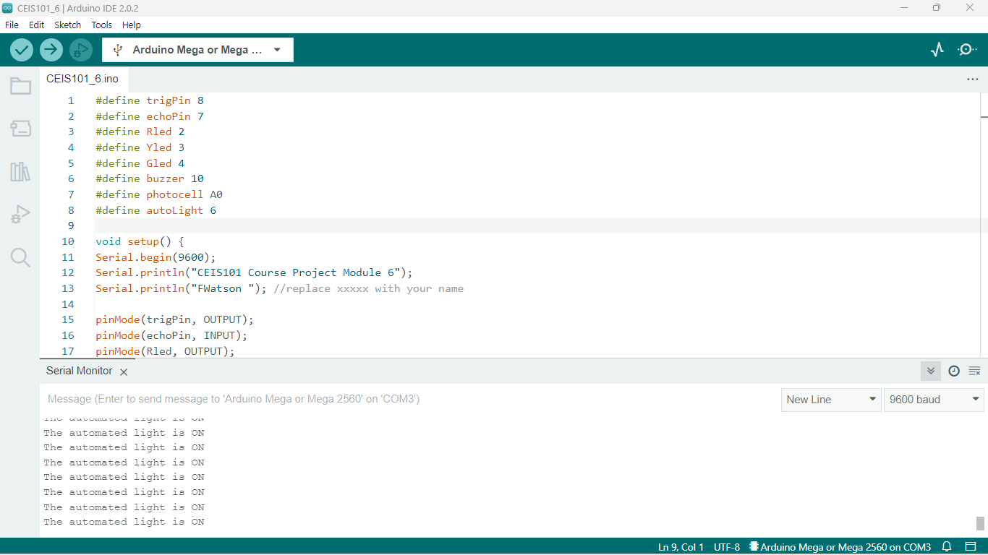
Arduino Code (screenshot)

Slide 31
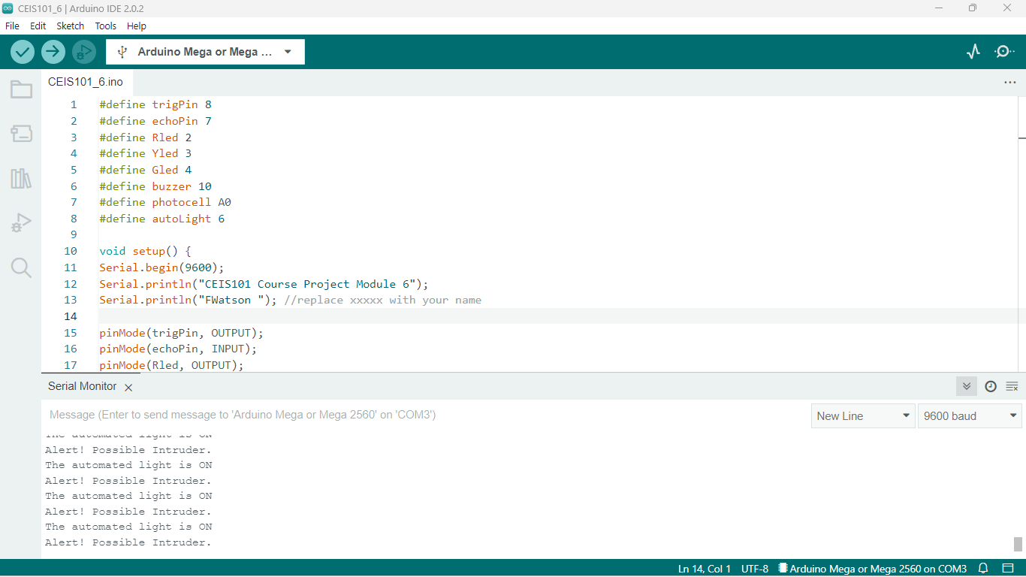
Serial Monitor (screenshot)

Slide 32


Challenges
While building this intelligent, innovative home security system. I got to familiarize myself with some of the sensors. I notice that they are favorable, but they operate differently. Arduino IDE 2.0.3 was also a challenge. I had to familiarize myself with navigating through this process.

Slide 33
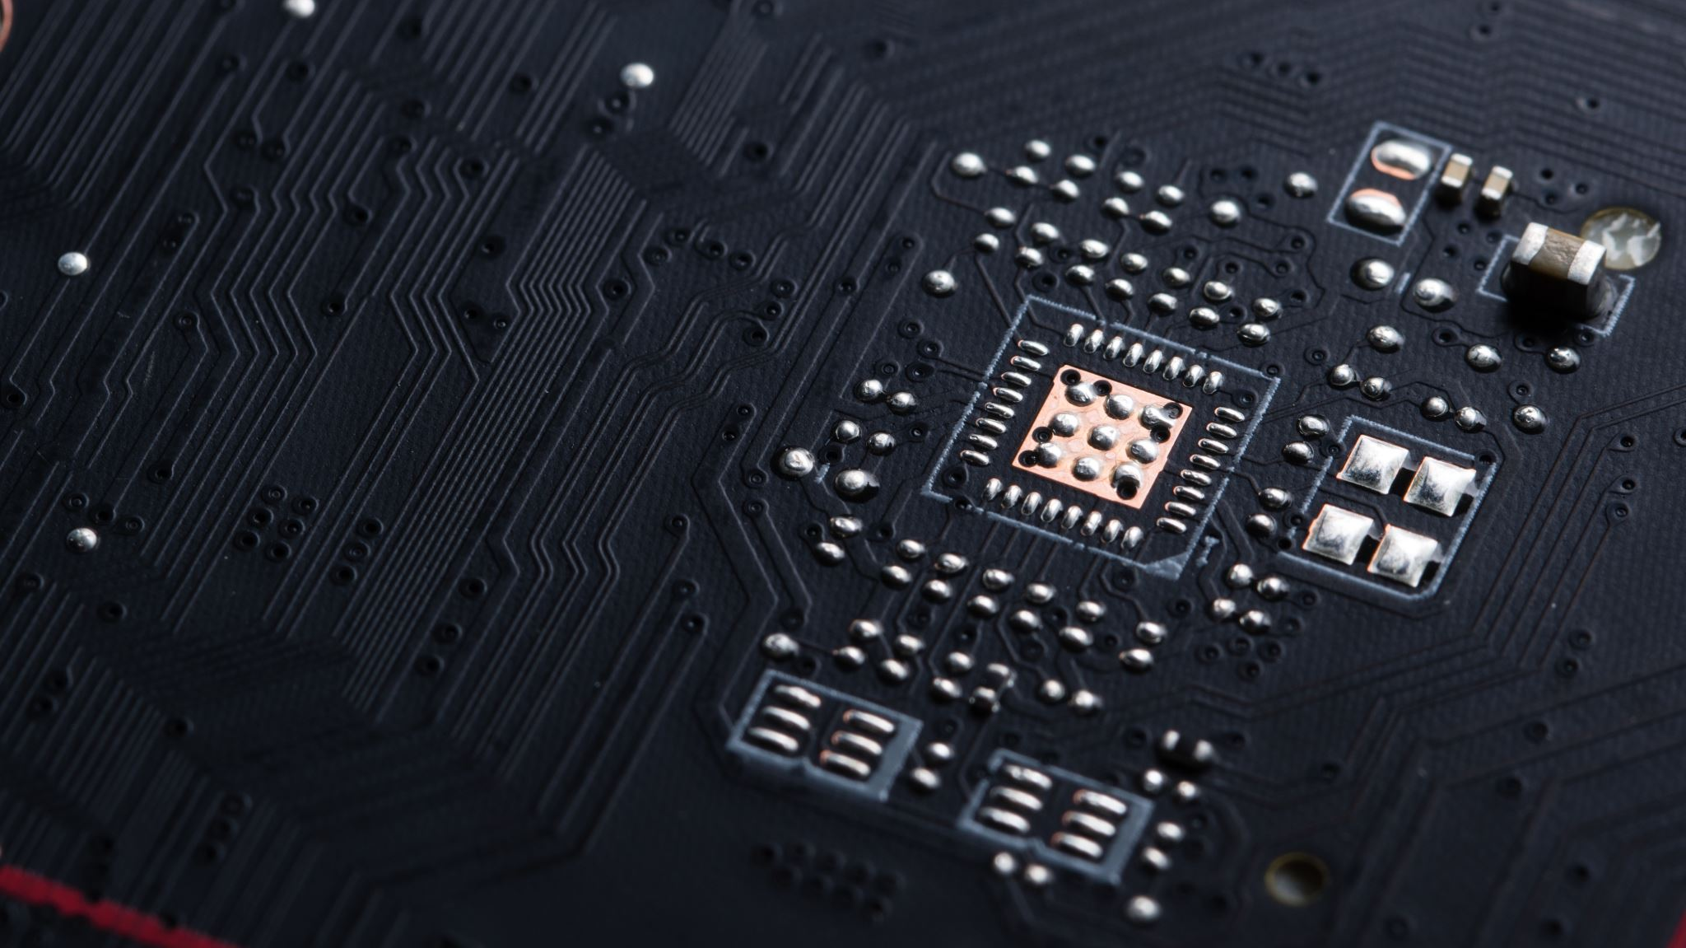
Career Skills
Programming in Python, C, C++
Sensor Operator
Circuit Design
Micro Processor and mini controller skills

Slide 34

Conclusion
This Intelligent Home system shows the IoT of People, Places, Data, and Devices (P2D2) working together. This system was built with an Ardunio 2560 R3 beginning in Tinkercad, showing circuit stimulation. Then moved to Ardunio IDE for the message displaying from programmed uploads. Displaying the output of an active secure, Intelligent home system. Displaying all levels of motion as well as the distance of the active motion. With data output that can be analyzed.

Slide 35

References
Devry University CEIS 101C
https://lms.devry.edu/lms/video/player.html?video=1_0xikq8em
https://lms.devry.edu/lms/video/player.html?video=1_bvjoql1o
https://lms.devry.edu/lms/video/player.html?video=1_otoo1zie
https://lms.devry.edu/lms/video/player.html?video=1_bihkxkqt
Tinkercad. (2011) Autodesk Technology, Web Java Script
Arduino Barragán, Hernando (2005). Programmable device

