Slide 1
CEIS110
Programming with Data
Felicia Watson

Slide 2
Introduction
Date is grown exponentially.
In this project a cloud-based system is used to obtain the temperature and humidity data for zip code 77070.
Then programming and data analytics will be used to analyze the data.

Slide 3
Software Inventory
Software had to be downloaded and installed in order to develop this programming the data necessary for this project.
Software necessary for this project includes a python IDE – anaconda, Excel and SQLite studio.

Slide 4
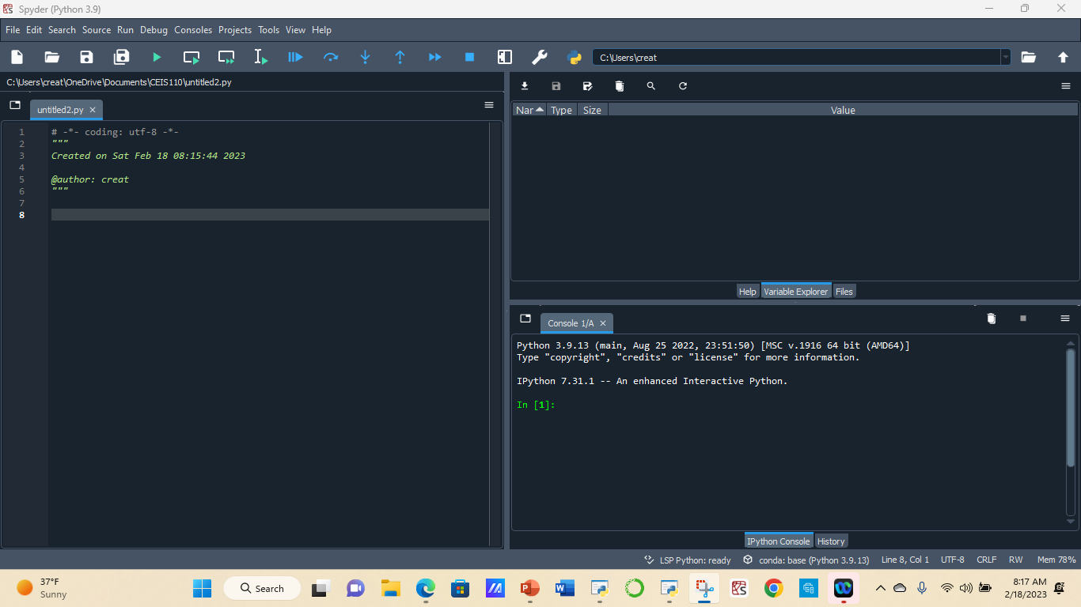
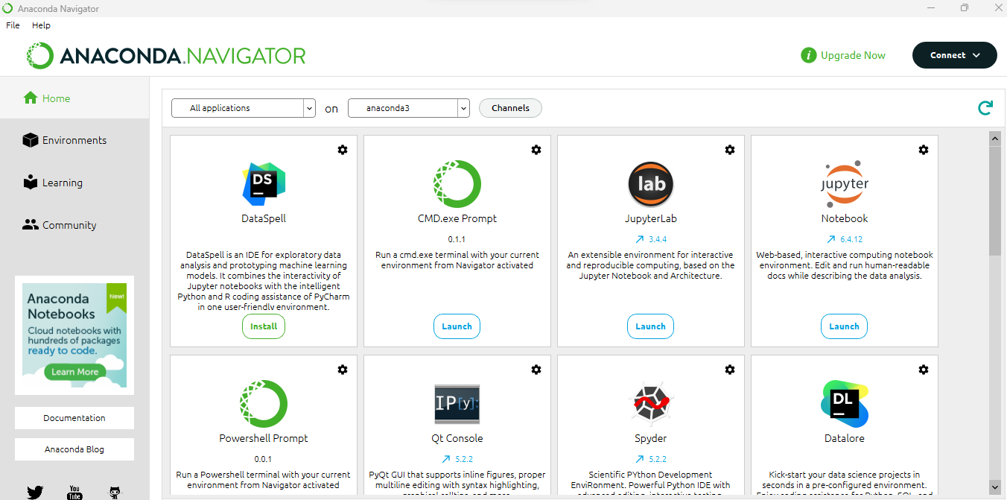
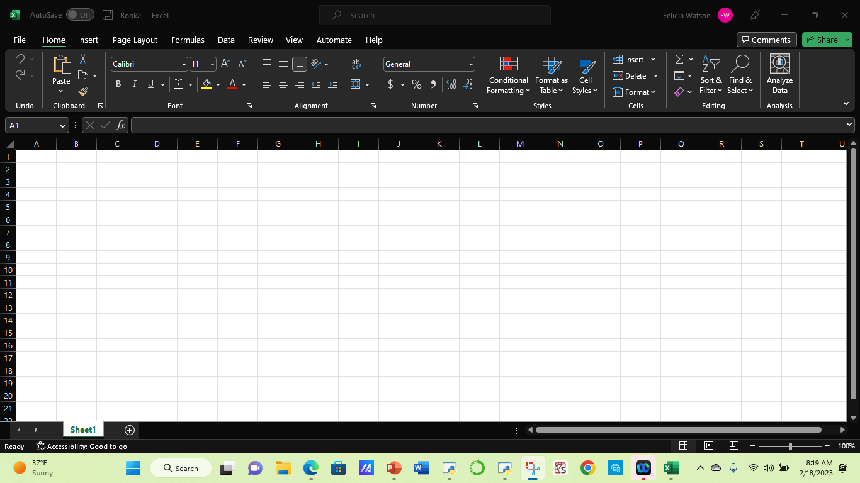
Screen Shots of Software Installed

Slide 5
CEIS110
Module 2

Slide 6

Objective
Design and Library setup
Create a solution for this working program that uses decisions and iteration with logical and relational expressions. Which led to the producing of a data analytics-based IoT system.
Screenshots
Flowchart
Software Library Installed

Slide 7
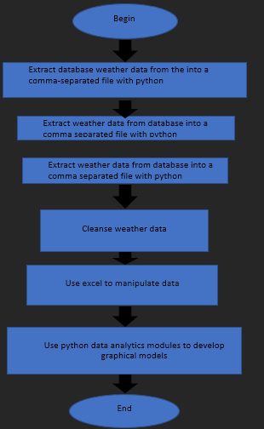
Flowchart
Include the following processes:
Install python
Download weather data to a database
Extract weather data from database into a comma separated file with python
Cleanse weather data
Use Excel to manipulate data
Use python data analytics modules to develop graphical models

Slide 8
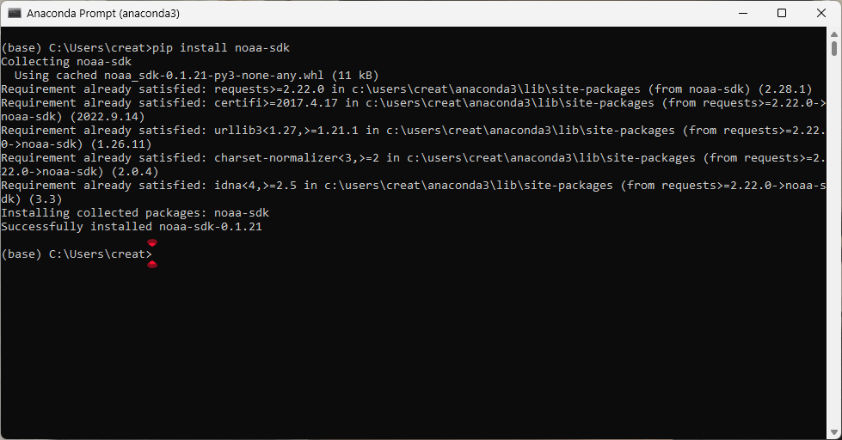
Software Inventory Installed Successfully (Screenshot)

Slide 9

CEIS110
Module 3

Slide 10

Objective Weather data downloaded
Create a working program solution that uses decisions and iteration with logical and relational expressions.
Produce a data analytics-based IoT system.

Slide 11
Rubric
Activity | Requirement(s) | Points
Code | Screenshot of code in Spyder with your name, date, and zip code | 10
Execution | Screenshot of Python console showing program ran successfully | 20
Database file | Screenshot from Windows Explorer showing database file was created | 20

Slide 12
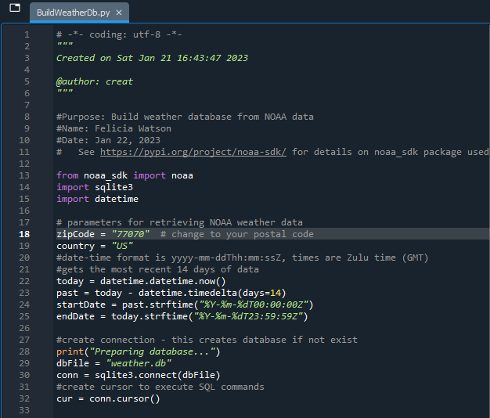
BuildWeatherDb.py Code (Screenshot)
Screenshot of code in Spyder
With my name and date in the comments
With my zip code

Slide 13
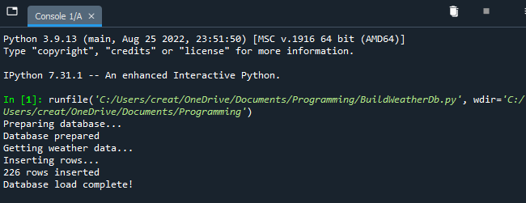
Python Console
(Screenshot)
Screenshot of program output in Python console showing program executed successfully

Slide 14
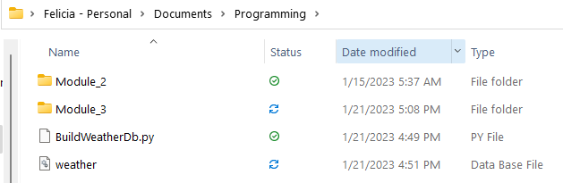
Weather.db File
(Screenshot)
Screenshot of Windows Explorer showing database file Weather.db was created

Slide 15
CEIS110
Module 4
Querying the database with SQL

Slide 16

Objective
Develop and test a program requiring a modular design.
Produce a data analytics-based IoT system.

Slide 17
Rubric
Activity | Requirement(s) | Points
Query to retrieve all columns and rows | Screenshot of query and results | 20
Query to retrieve lowest and highest temperature | Screenshot of query and results | 20
Query to find all Clear days | Screenshot of query and results | 20

Slide 18
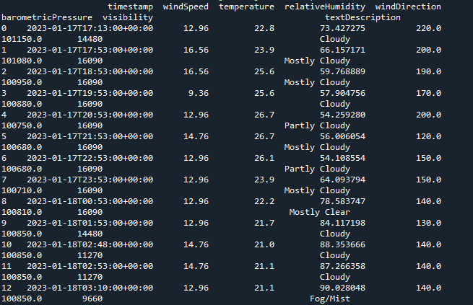
Query to retrieve all columns and all rows (Screenshot)
Screenshot of SQL query command and results

Slide 19
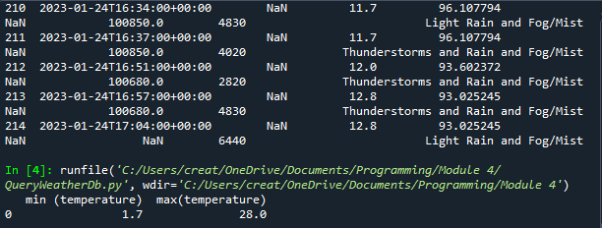
Query to retrieve lowest and highest temperatures
(Screenshot)
Screenshot of SQL query command and results

Slide 20
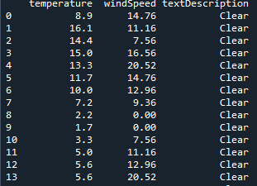
Query only retrieve all clear days
(Screenshot)
    Screenshot of SQL query command and results

Slide 21
CEIS110
Module 5
Querying and manipulating data with SQL and Python

Slide 22
Objective
Manipulate Data by
Designing , code, and test a working program using an array or list data structure.
Produce a data analytics-based IoT system.

Slide 23
Rubric
Activity | Requirement(s)
Python code | Screenshot of code
Retrieve and convert data into CSV format | Screenshot of data in Excel file
Temperature and Humidity chart | Chart of data from database

Slide 24
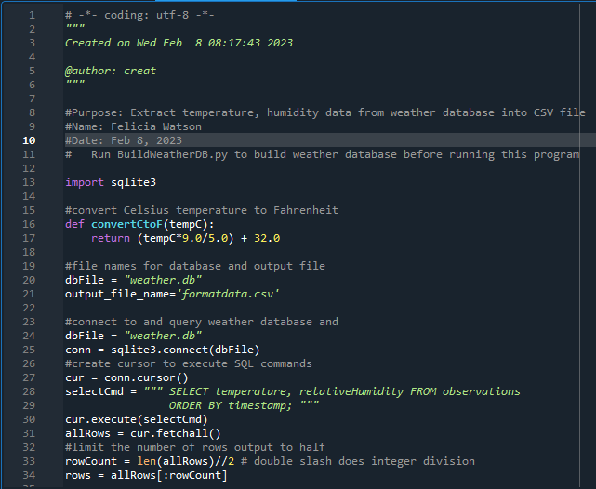
Python code (Screenshot of file)
ExtractTempHumidity.py Python code with your name and date in comments

Slide 25
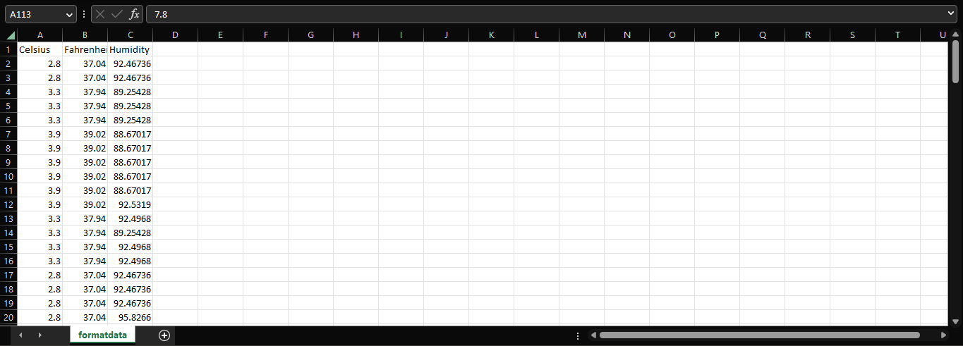
Retrieve and Convert Data to CSV Format (Screenshot)
Format data file in Excel showing 3 columns of data

Slide 26
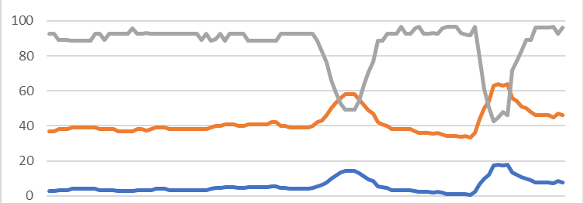
Temperature and Humidity Chart
(Graph)
Excel chart based on temperature and humidity data from database

Slide 27
CEIS110
Module 6

Slide 28

Objective
Produce a data analytics-based IoT system by Developing graphical models, and then interpret the results

Slide 29
Rubric
Activity | Requirement(s)
Plot #1 | Picture/screenshot of plot from data with code
Plot #2 | Picture/screenshot of plot from data with code
Analysis | Question, plot, and answer
Prediction | Prediction based on data

Slide 30
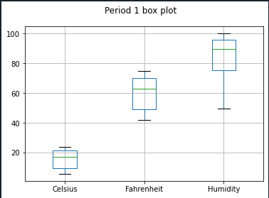
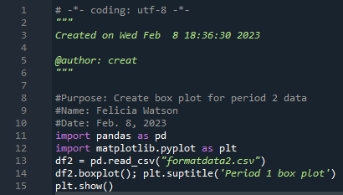
Plot #1
(Screenshots)
Plot and code used to generate it
Box

Slide 31
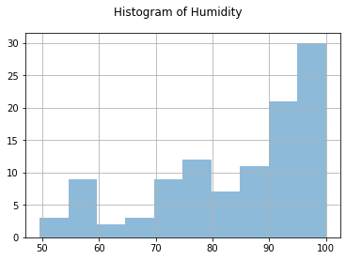
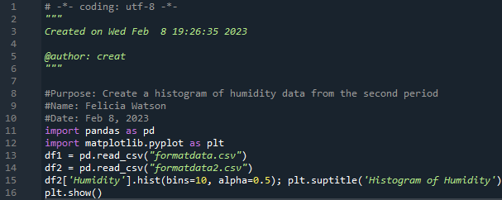
Plot #2(Screenshots)
Plot#2 and code used to generate it
Histogram

Slide 32
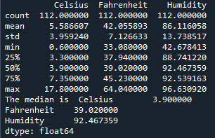
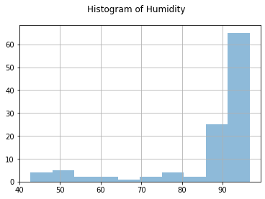
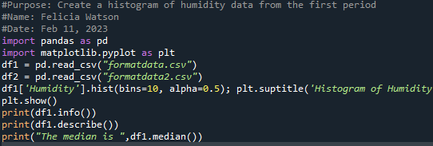

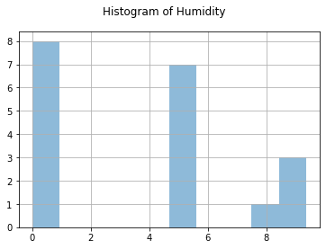
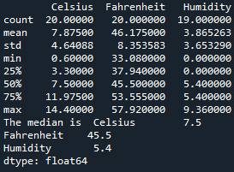
ANALYSIS
What is the median humidity for both weeks?
Week 1
Week 2

Slide 33

Prediction
I observed that the median humidity for week one was high. And week two median humidity was at mid point. For the next few hours. I think that the humidity will be consistent. But if the temperature of the weather becomes warmer the humidity will rise.

Slide 34
Challenges
After installing the noaa library successfully. My anaconda wouldn’t work properly.
Copied files from a previous installation of Anaconda.

Slide 35
Career Skills
Skills obtained from this project
Programming using python Python
Database Development
Using a Flowchart to Illustrate the project
Data Cleansing
Analysis-making prediction on data by evaluating graphs and charts

Slide 36
Conclusion
Programming with data analytics was a good hands-on experience for me. Doing this project, Programming with data. I was introduced to languages that I didn’t know existed, by using data gathered form a cloud service to perform data analytics operation.

